Slide 1
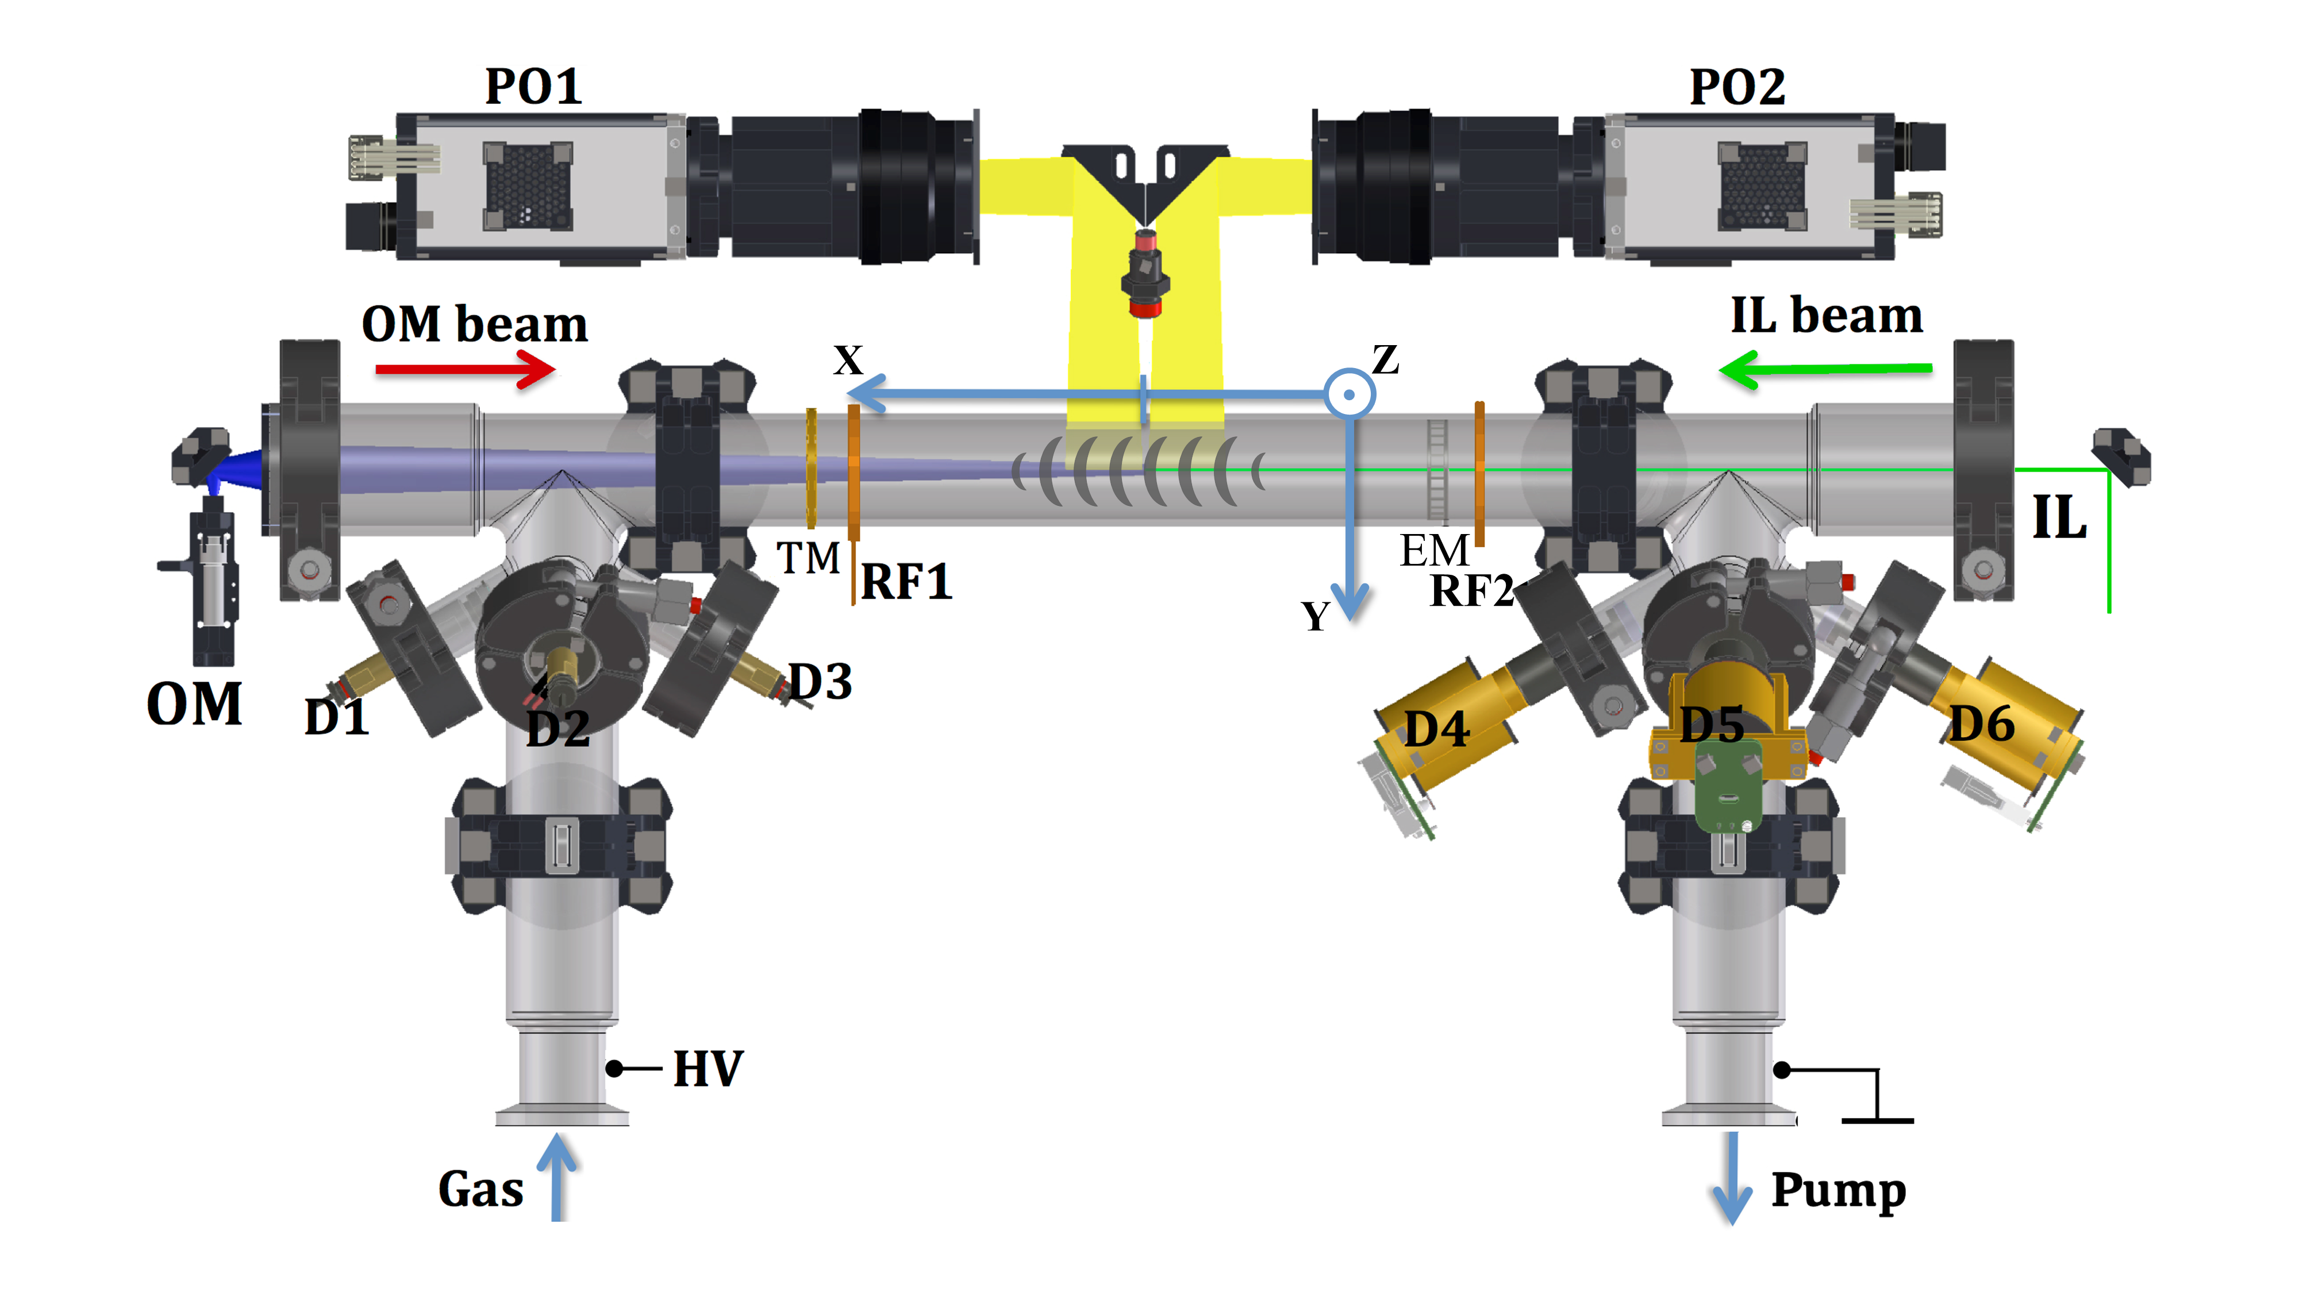
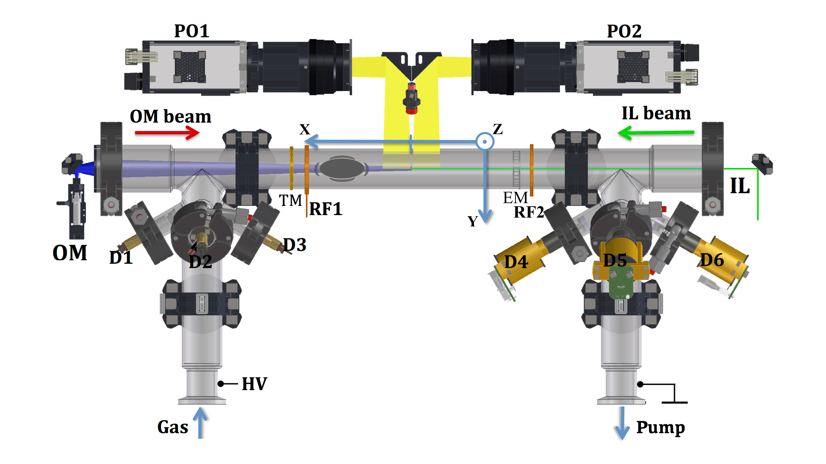

Introduction
1.
1b.
2.
2b.
Forward (F)
Backward (B)
I = - 0.5 mA
I = 0.5 mA

Slide 2
Introduction
V_group
Forward (F)
Backward (B)
I = - 0.5 mA
I = 0.5 mA

Slide 3
Introduction
C_daw = v_group – v_phase_measured
V_group
Forward (F)
Backward (B)
I = - 0.5 mA
I = 0.5 mA

Slide 4
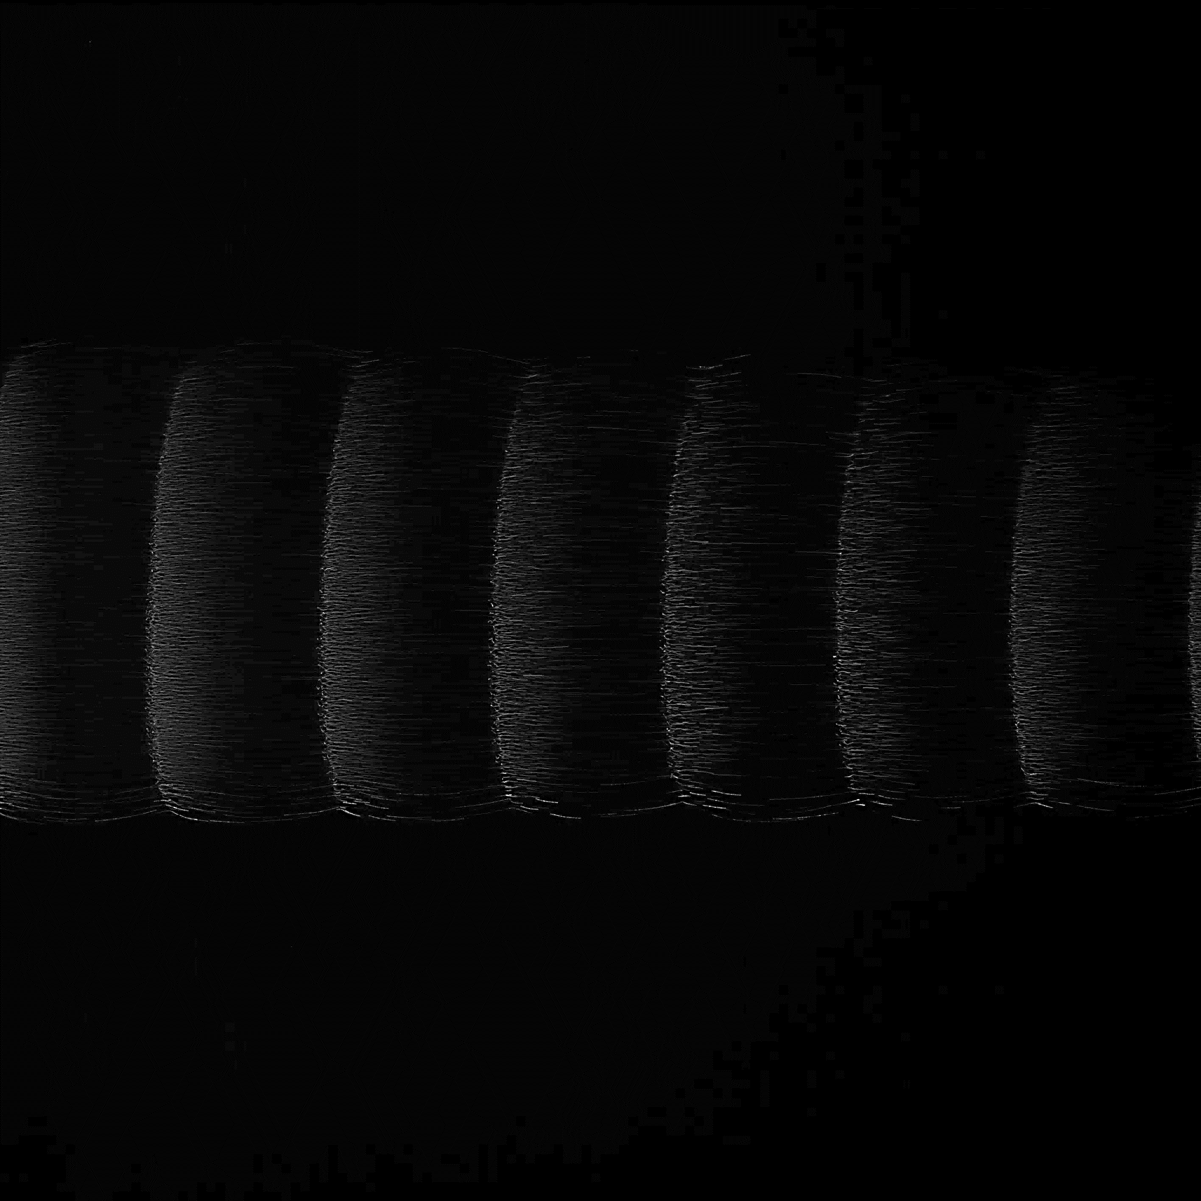
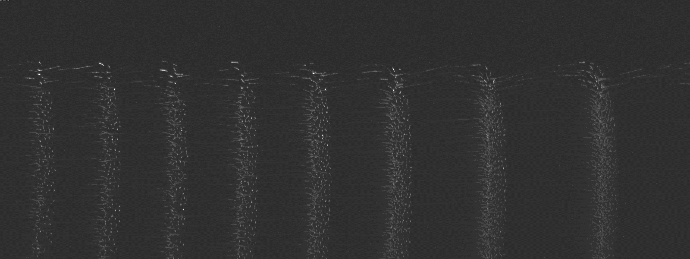
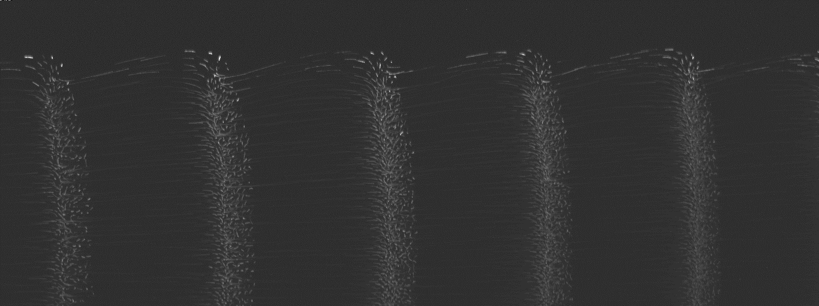
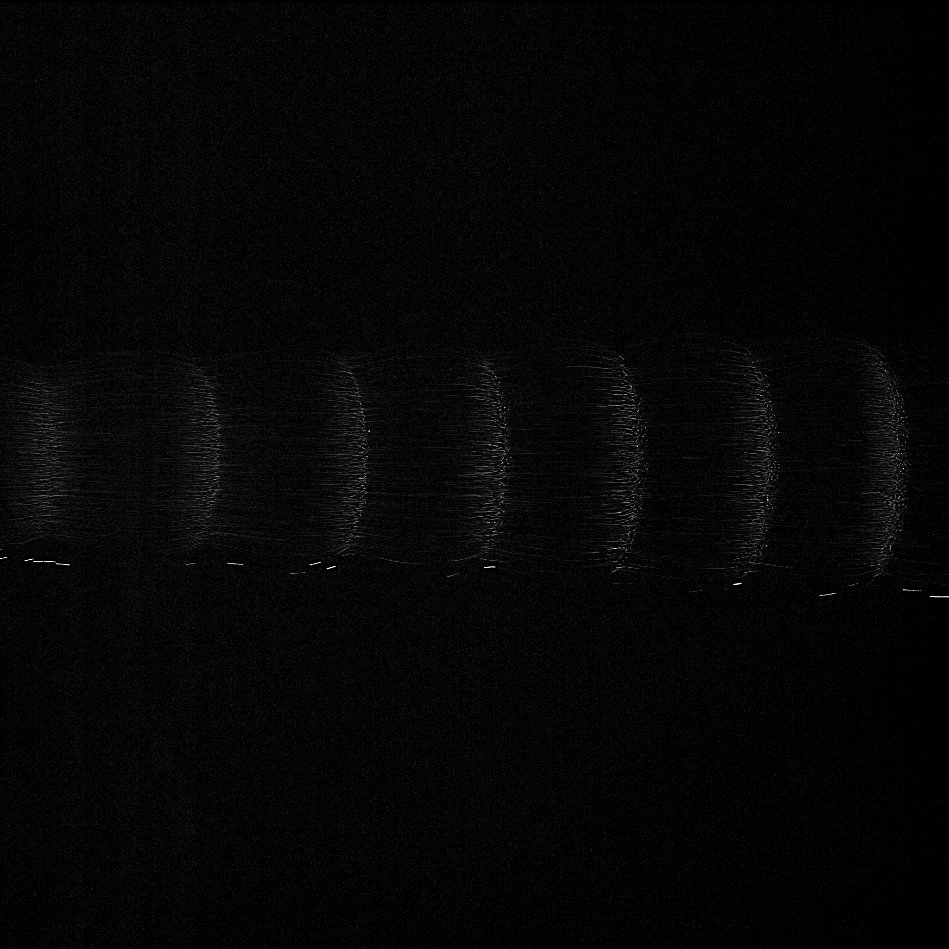
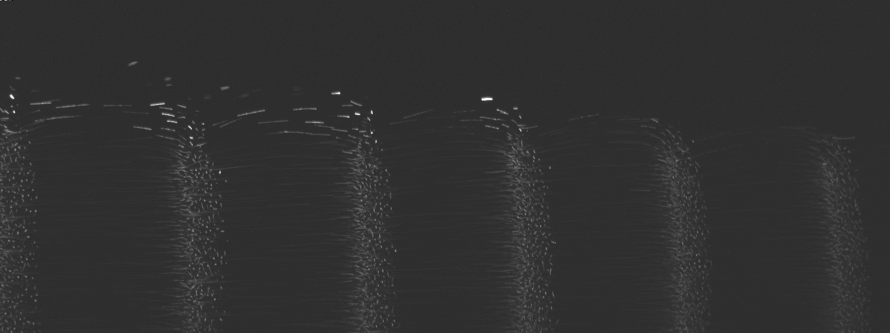

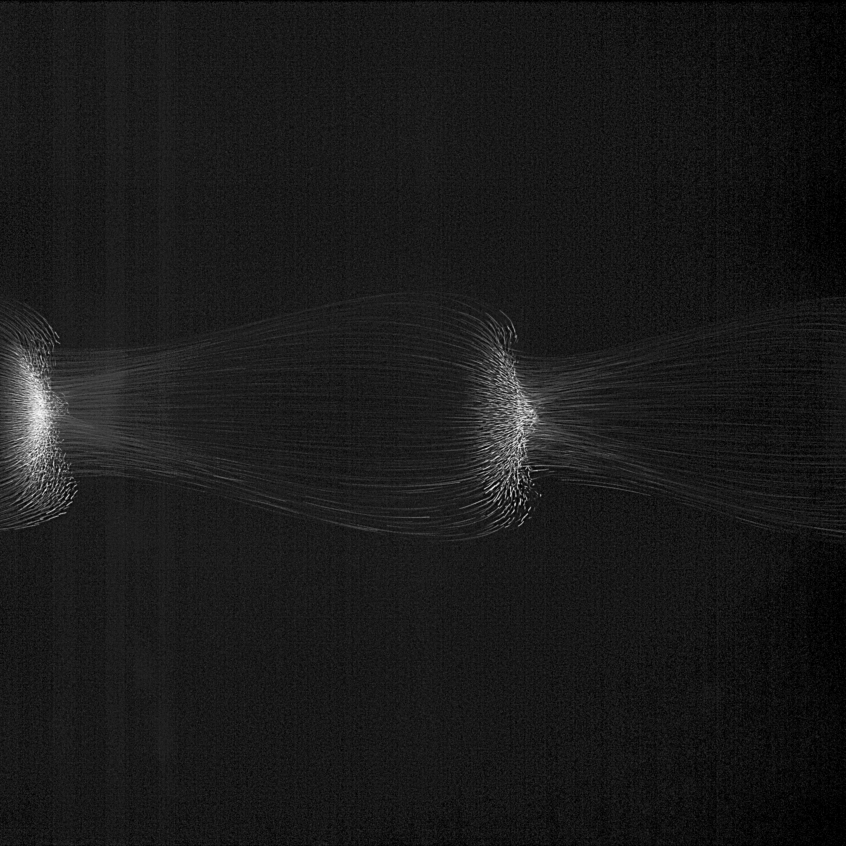
2 mm
PFC
40 Pa
2 mm
ISS
30 Pa
25 Pa
20 Pa
15 Pa

Slide 5
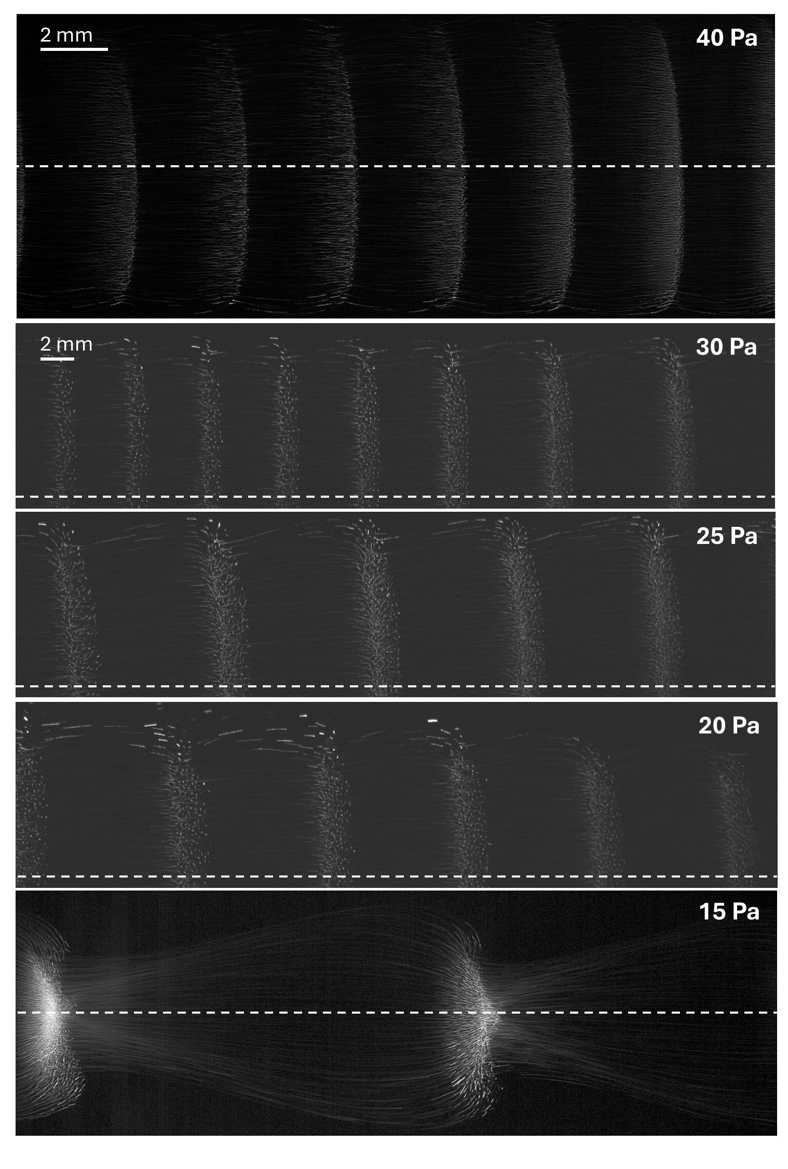
PFC
ISS

Slide 6
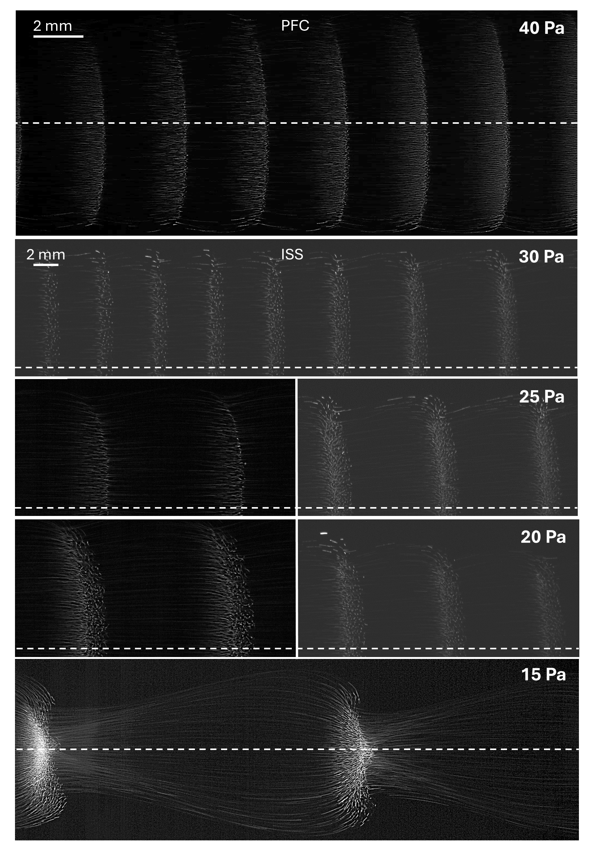

Slide 7
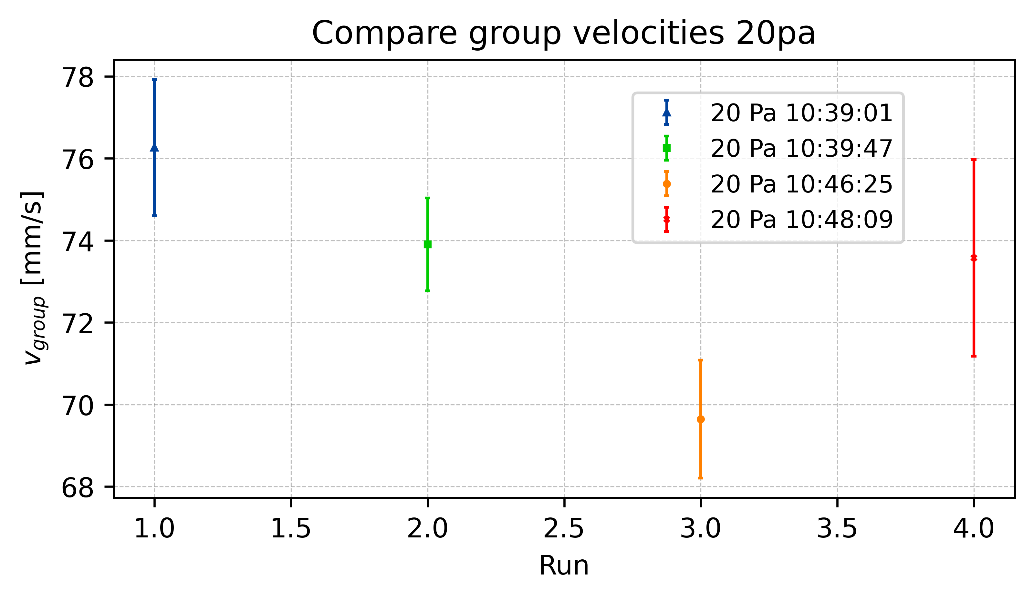
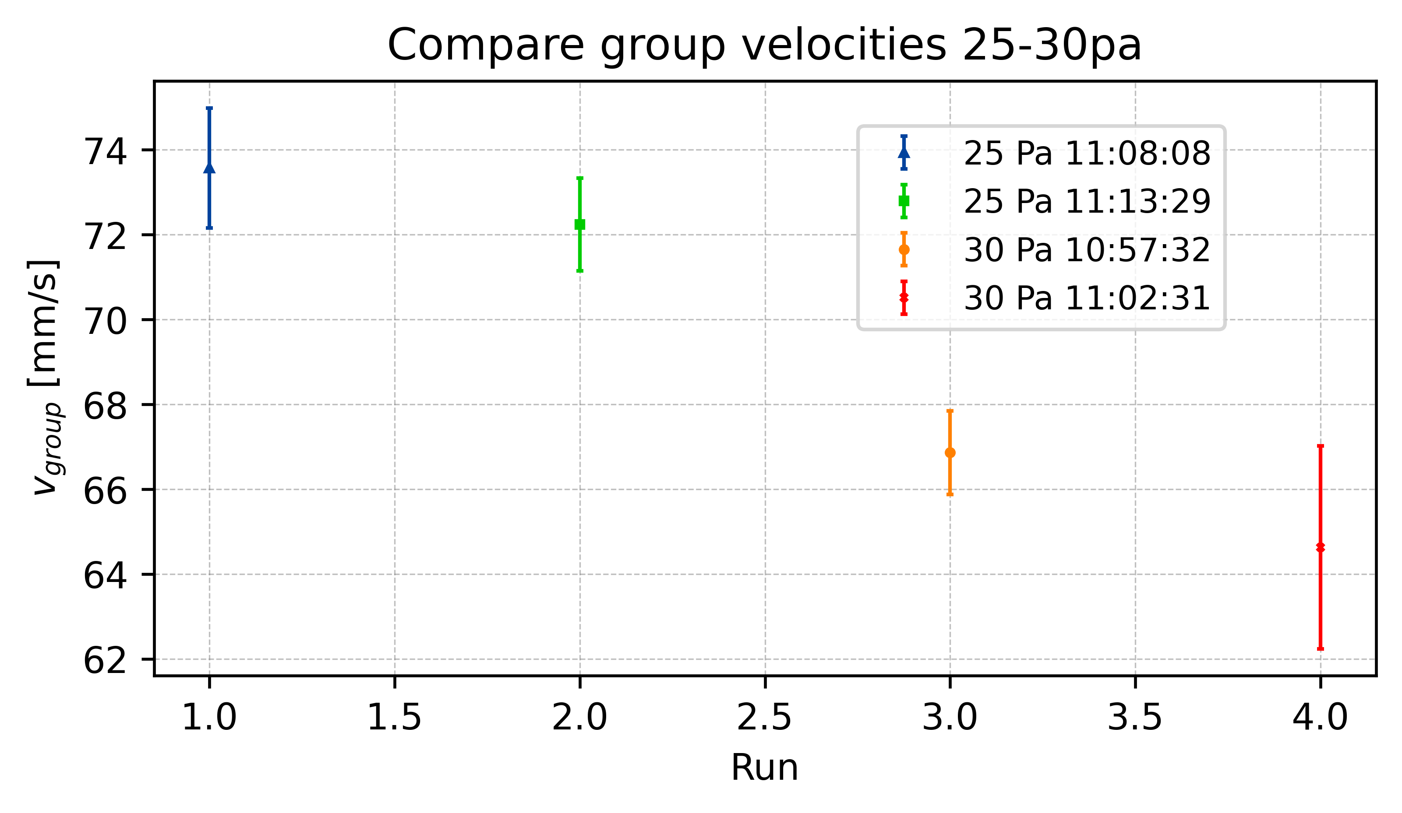
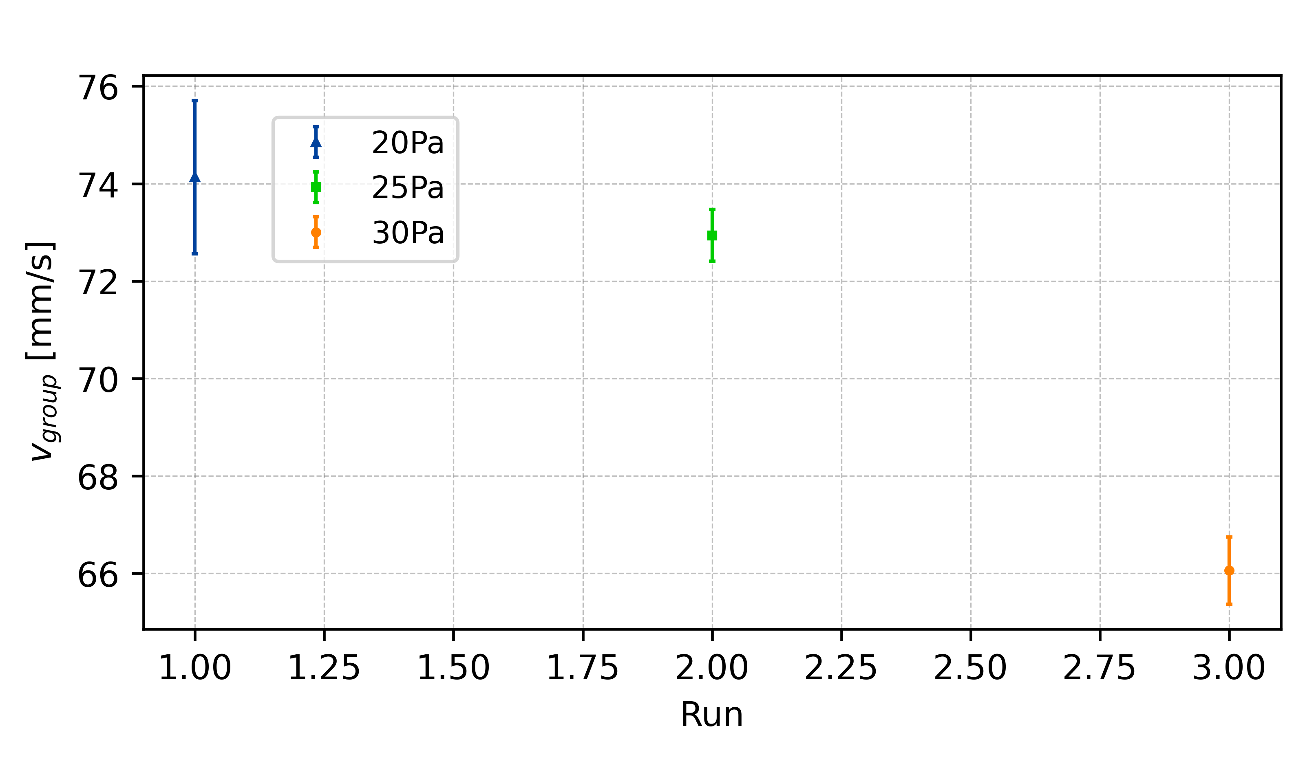
Group Velocity

Slide 8
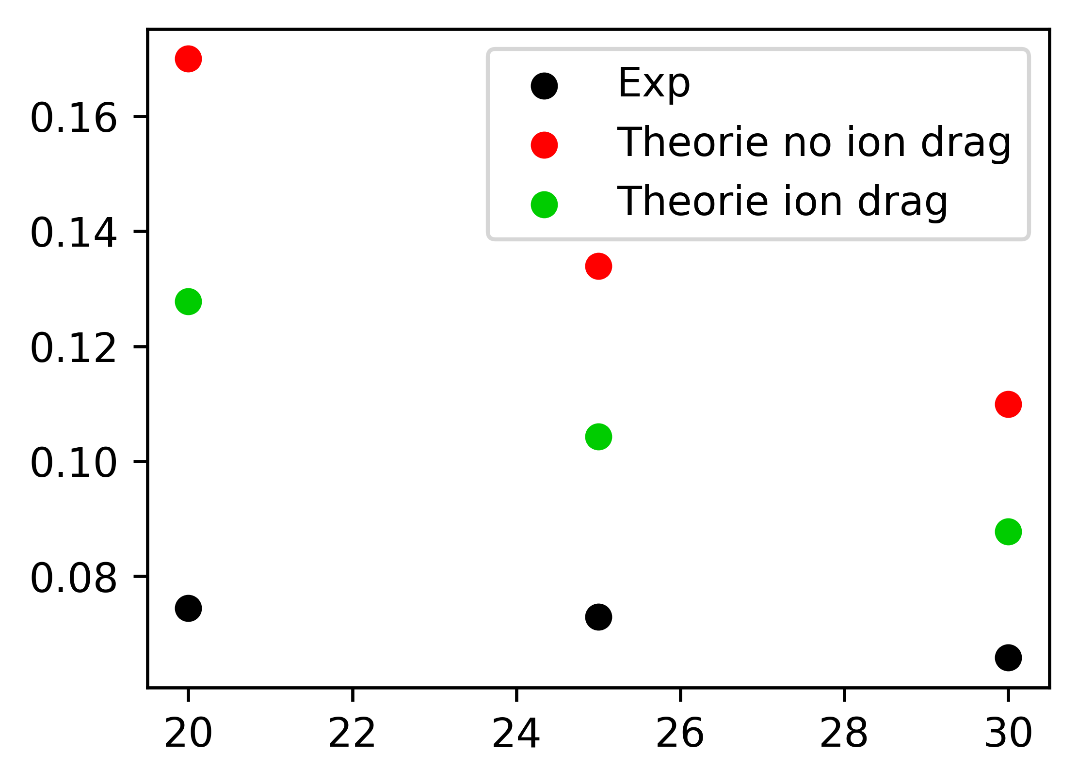
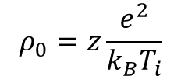
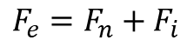
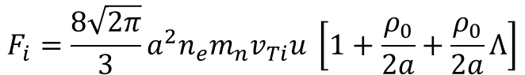
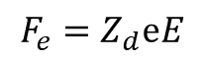
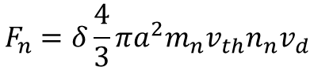
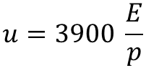
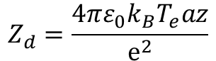
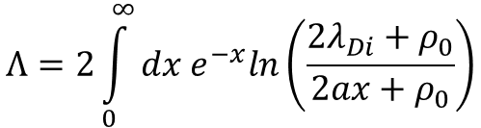
Theoretical Group Velocity
Khrapak et. al.
$$F_{e}=F_{n}+F_{i}$$
$$F_{e}=Z_{d}ⅇE$$
Z=0.345
$$F_{n}=δ\frac{4}{3}πa^{2}m_{n}v_{th}n_{n}v_{d}$$
$$F_{i}=\frac{8\sqrt{2π}}{3}a^{2}n_{e}m_{n}v_{Ti}u \left[1+\frac{ρ_{0}}{2a}+\frac{ρ_{0}}{2a}Λ\right]$$
$$ρ_{0}=z\frac{e^{2}}{k_{B}T_{i}}$$
$$Λ=2\int_{0}^{∞}{dx e^{−x}ln\left(\frac{2λ_{Di}+ρ_{0}}{2ax+ρ_{0}}\right)}$$
$$u=3900 \frac{E}{p}$$
$$Z_{d}=\frac{4πε_{0}k_{B}T_{e}az}{ⅇ^{2}}$$

Slide 9
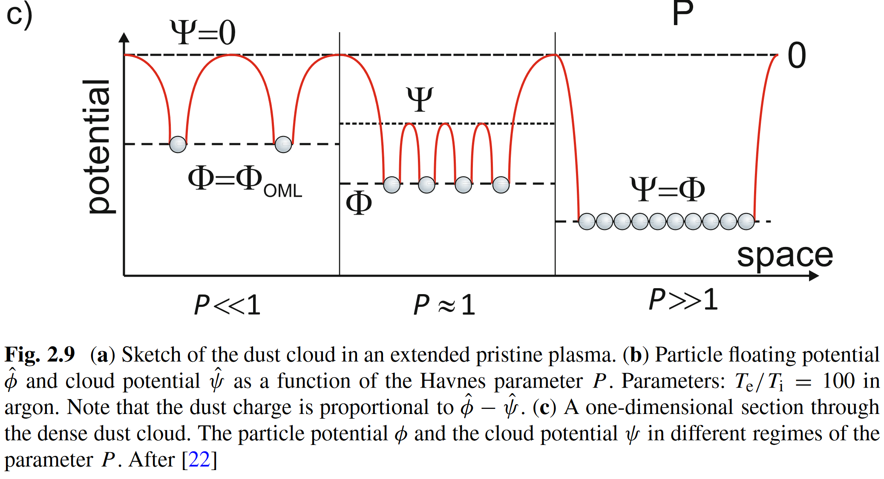
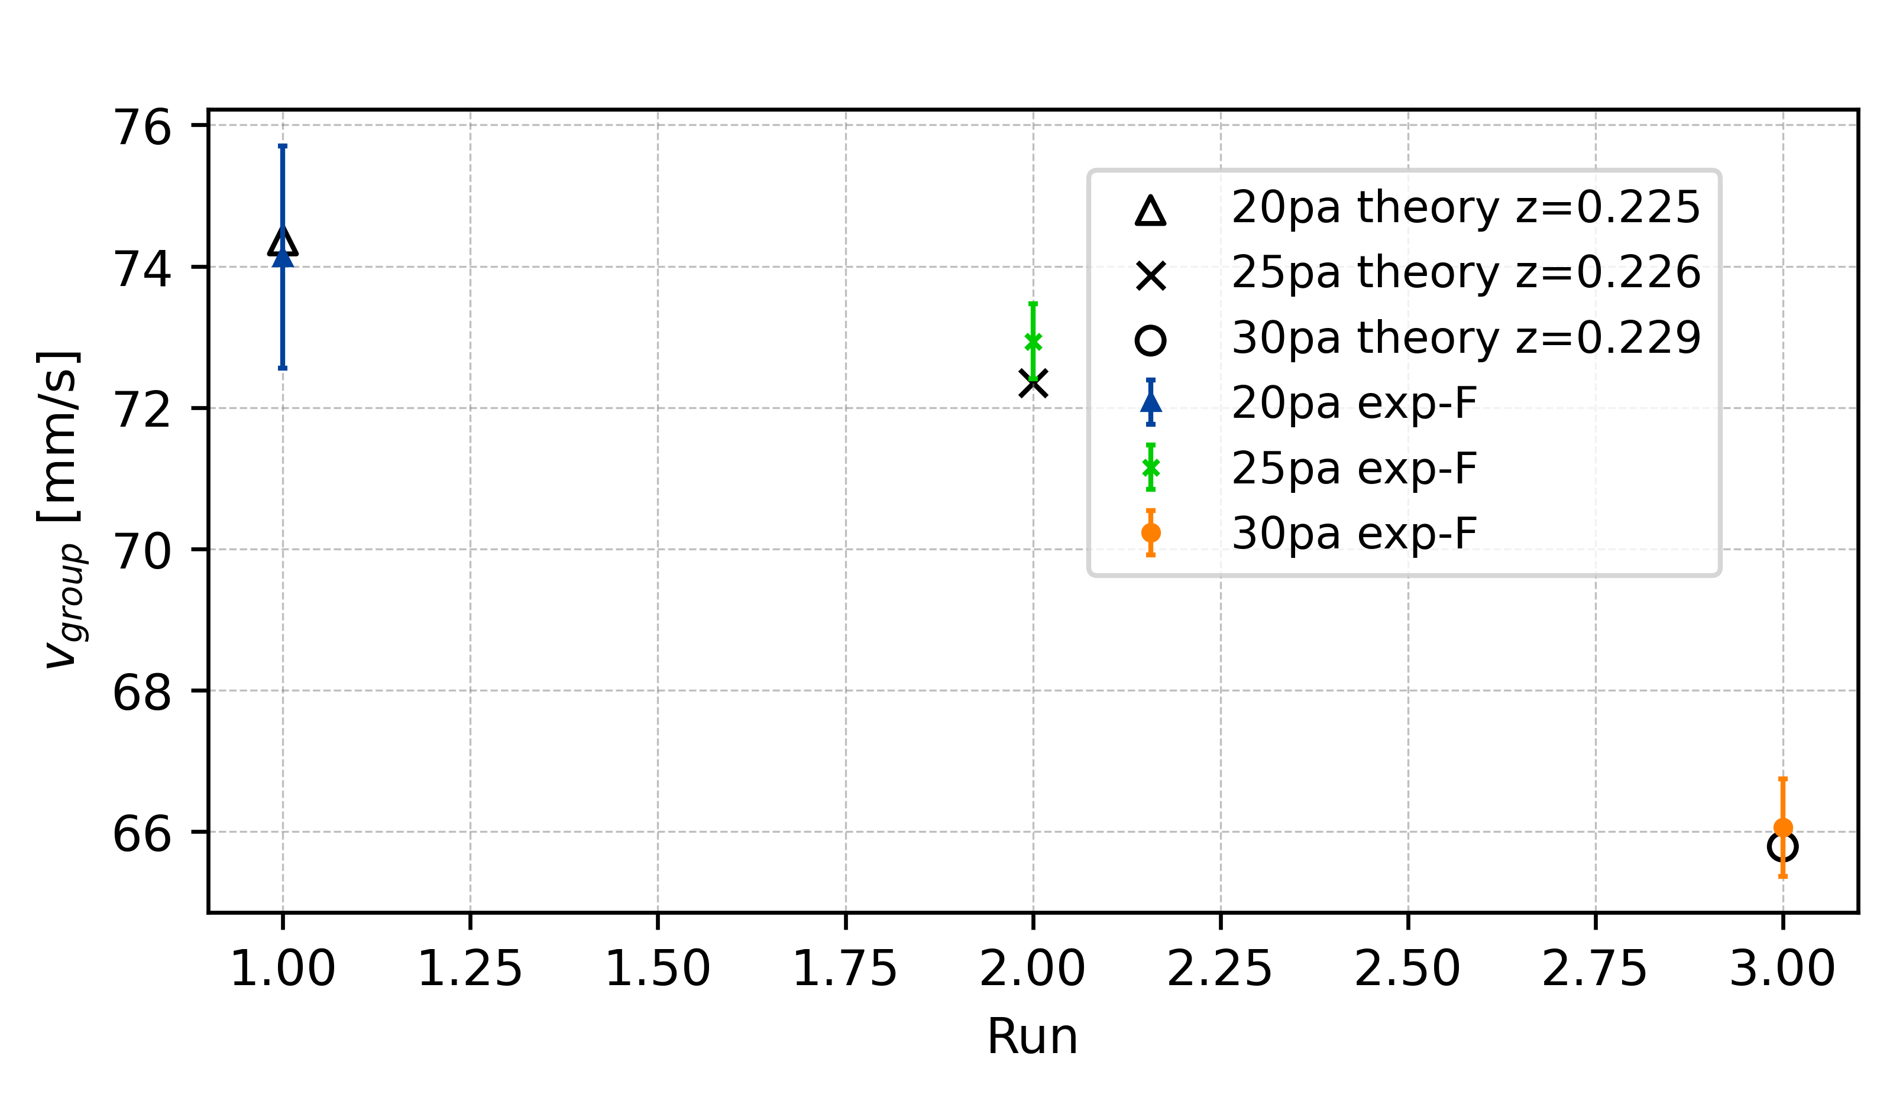
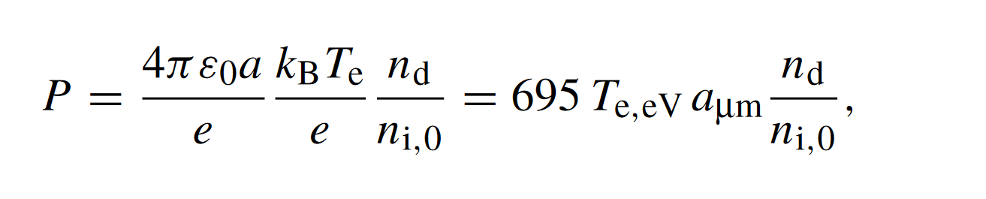
Charge Depletion – Havnes Parameter
[20Pa, 25Pa, 30Pa]
[2.047, 1.967, 1.899, 1.838]
New z from depletion theory

Slide 10
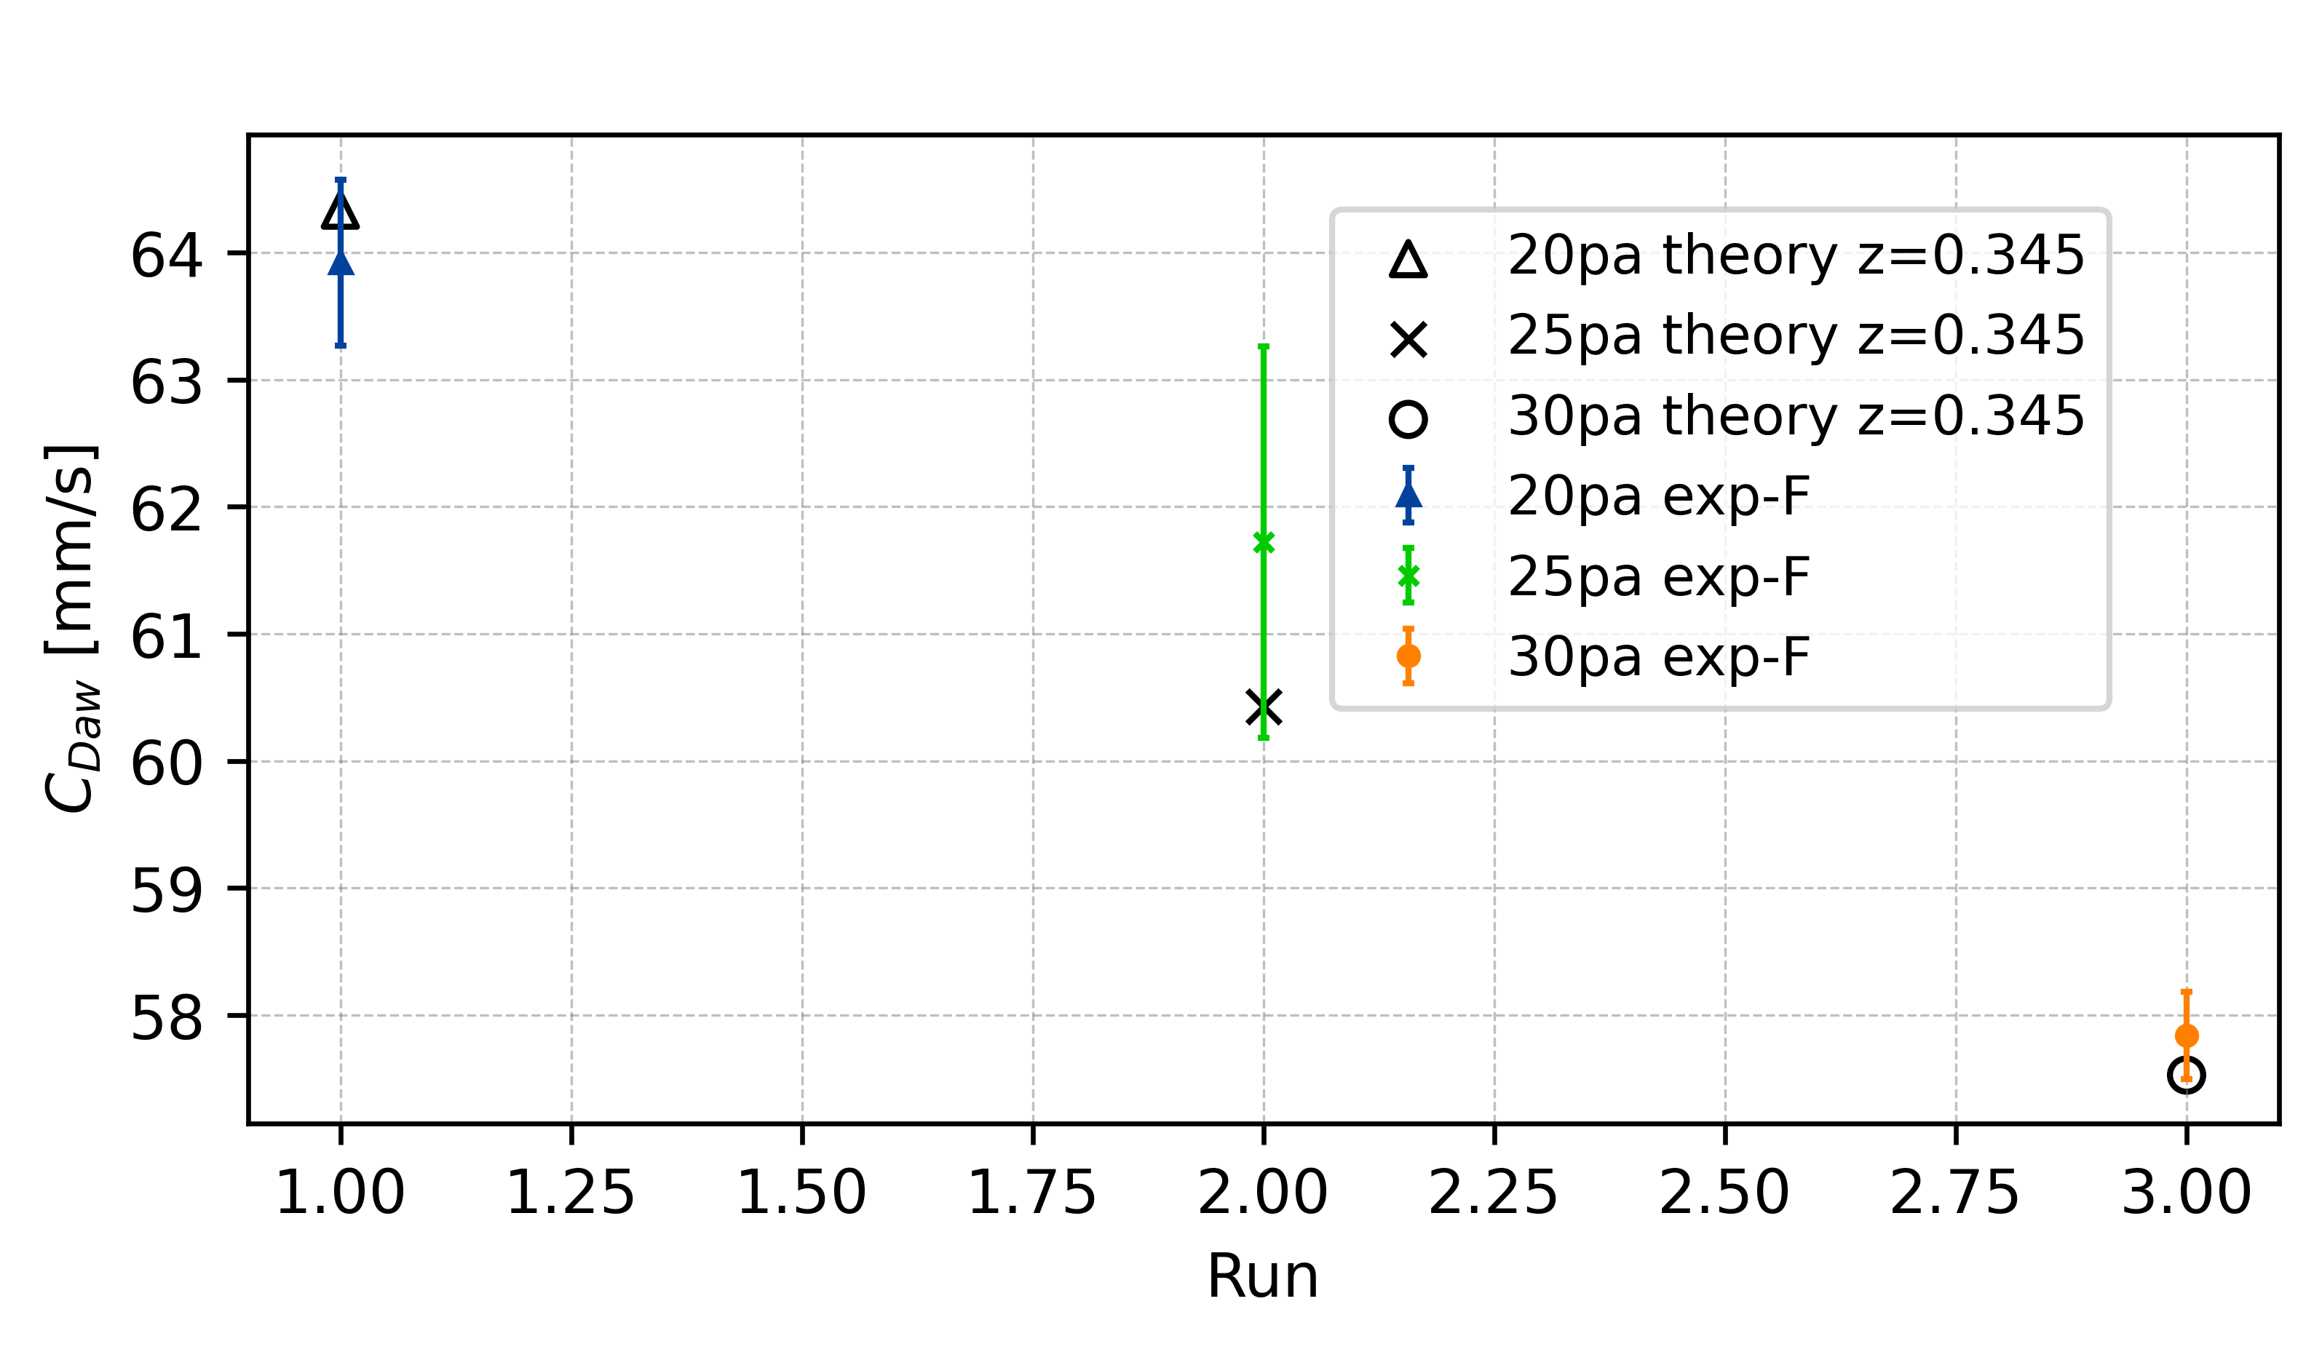
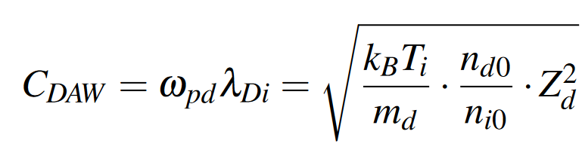
Dust-accoustic wave phase speed – C_{DAW}
Charge depletion is not playing a role in wave propagation
Charge reduction of individual particle is trigger effect of collective wave phenomena

Slide 11
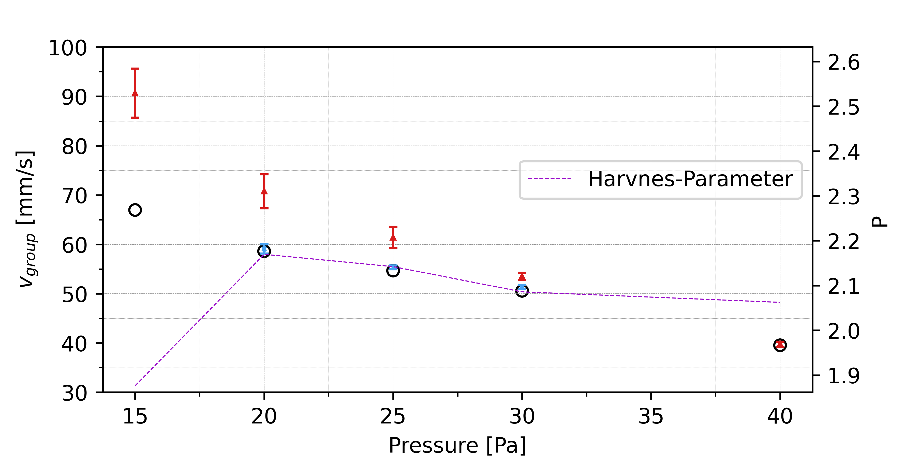
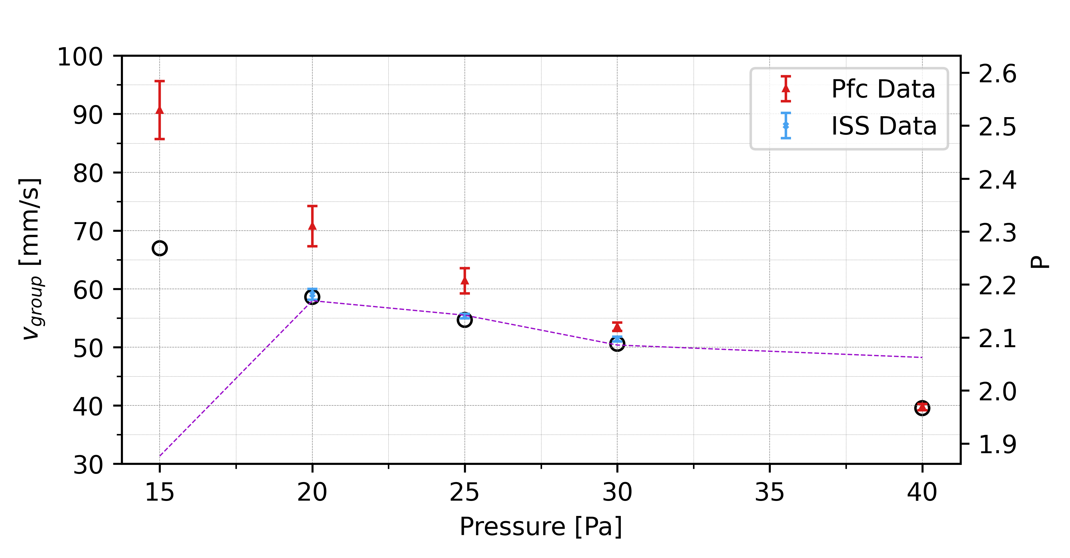
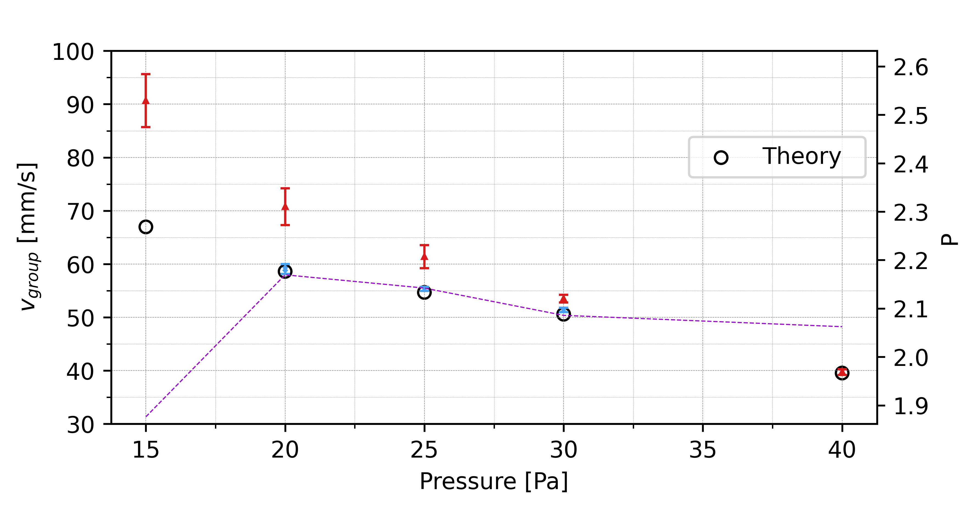

Slide 12
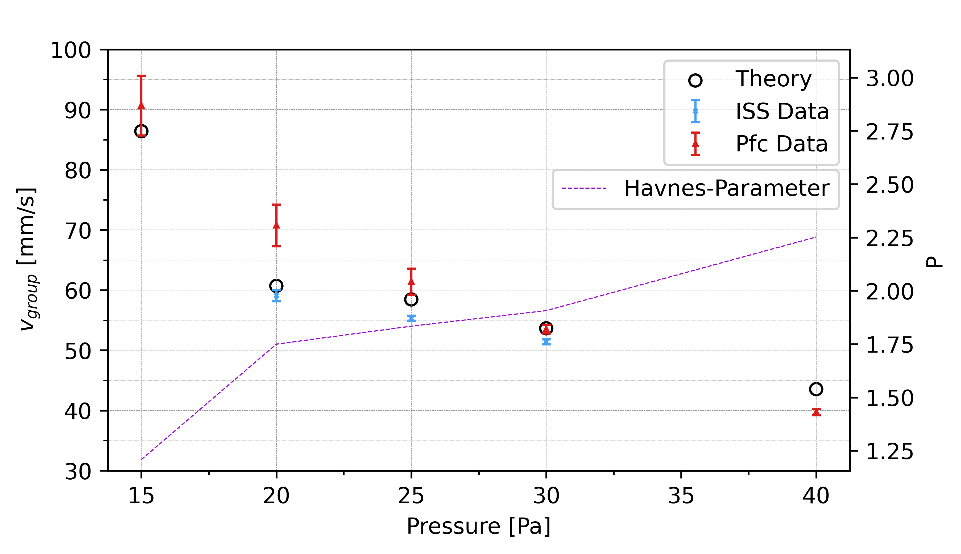
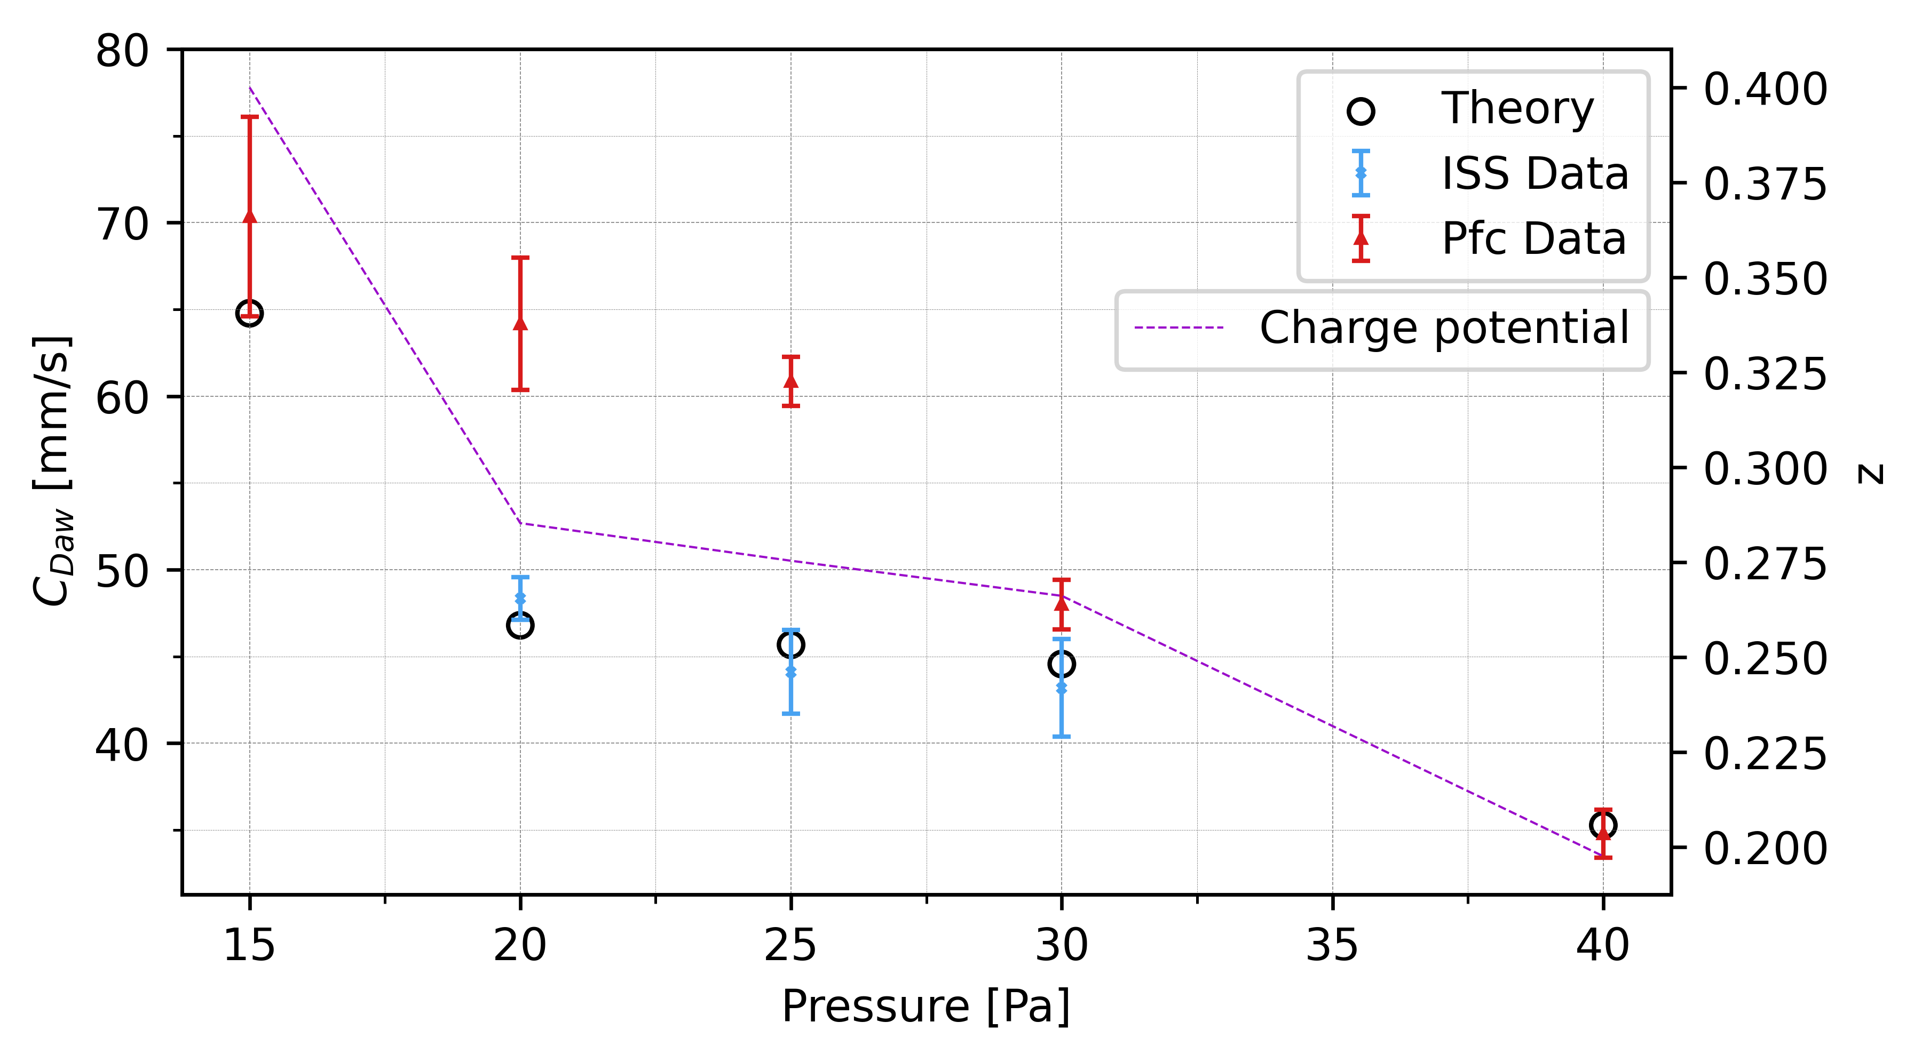

Slide 13
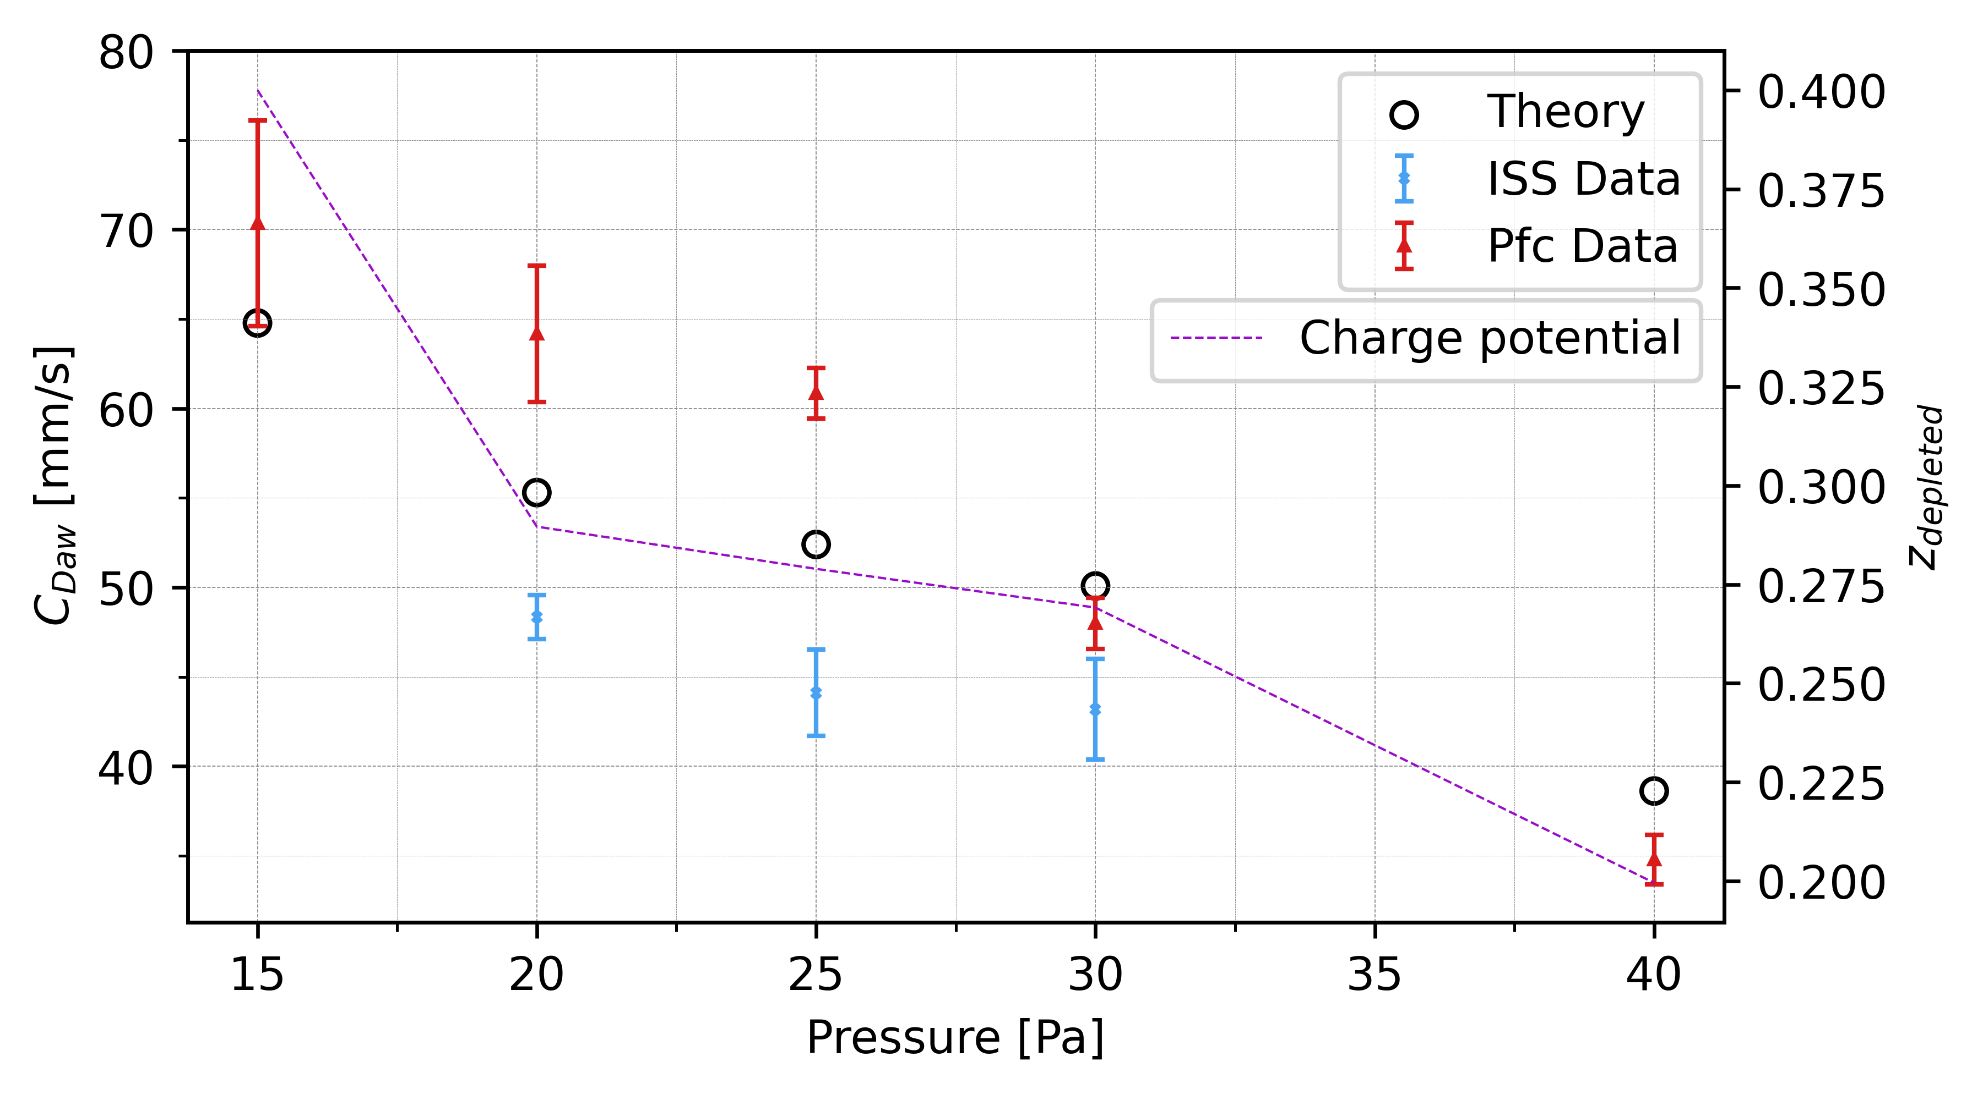

Slide 14
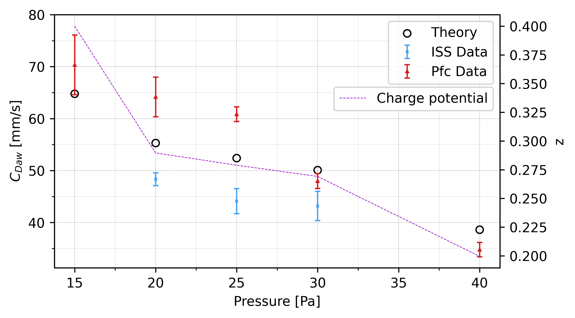
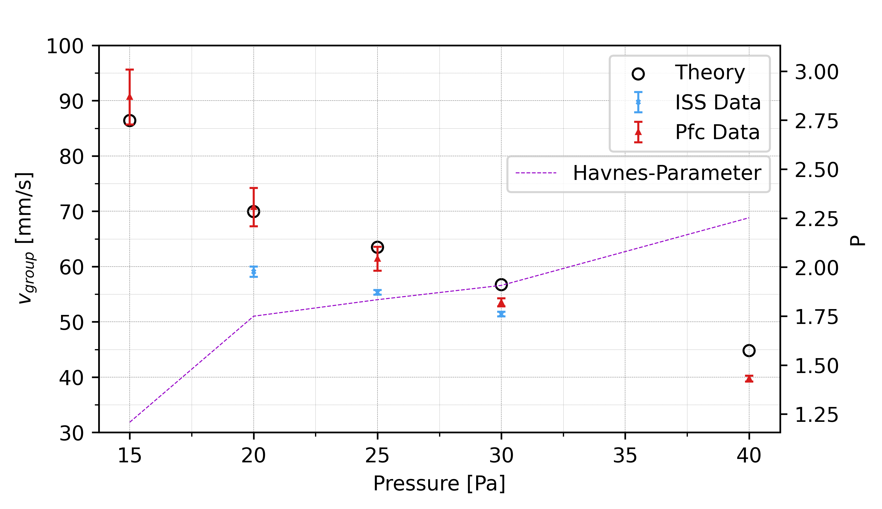

Slide 15
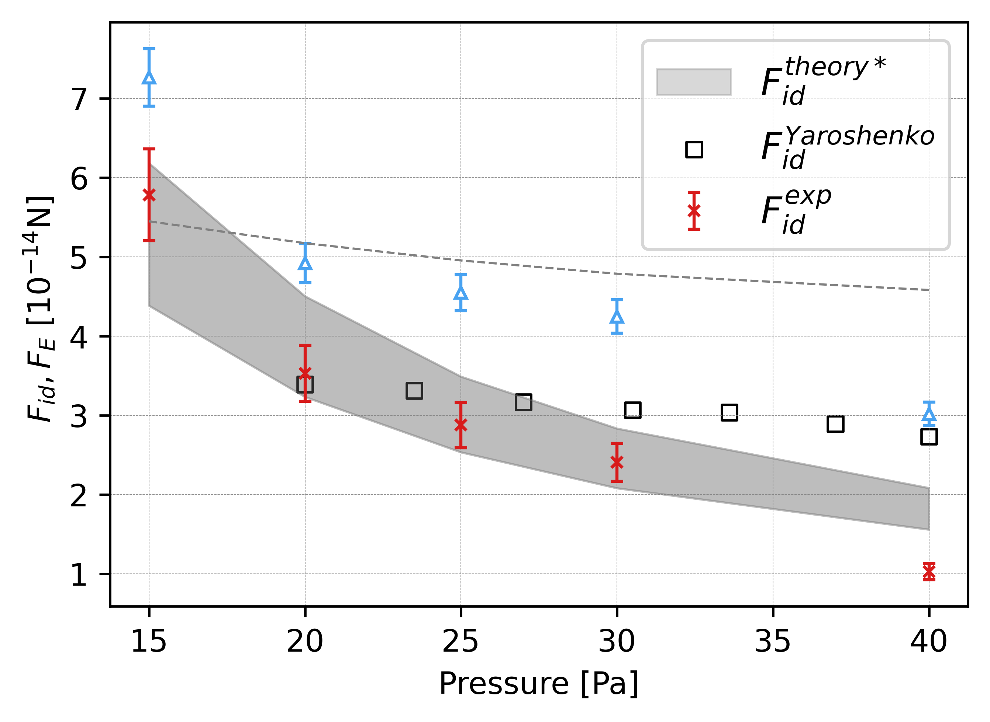
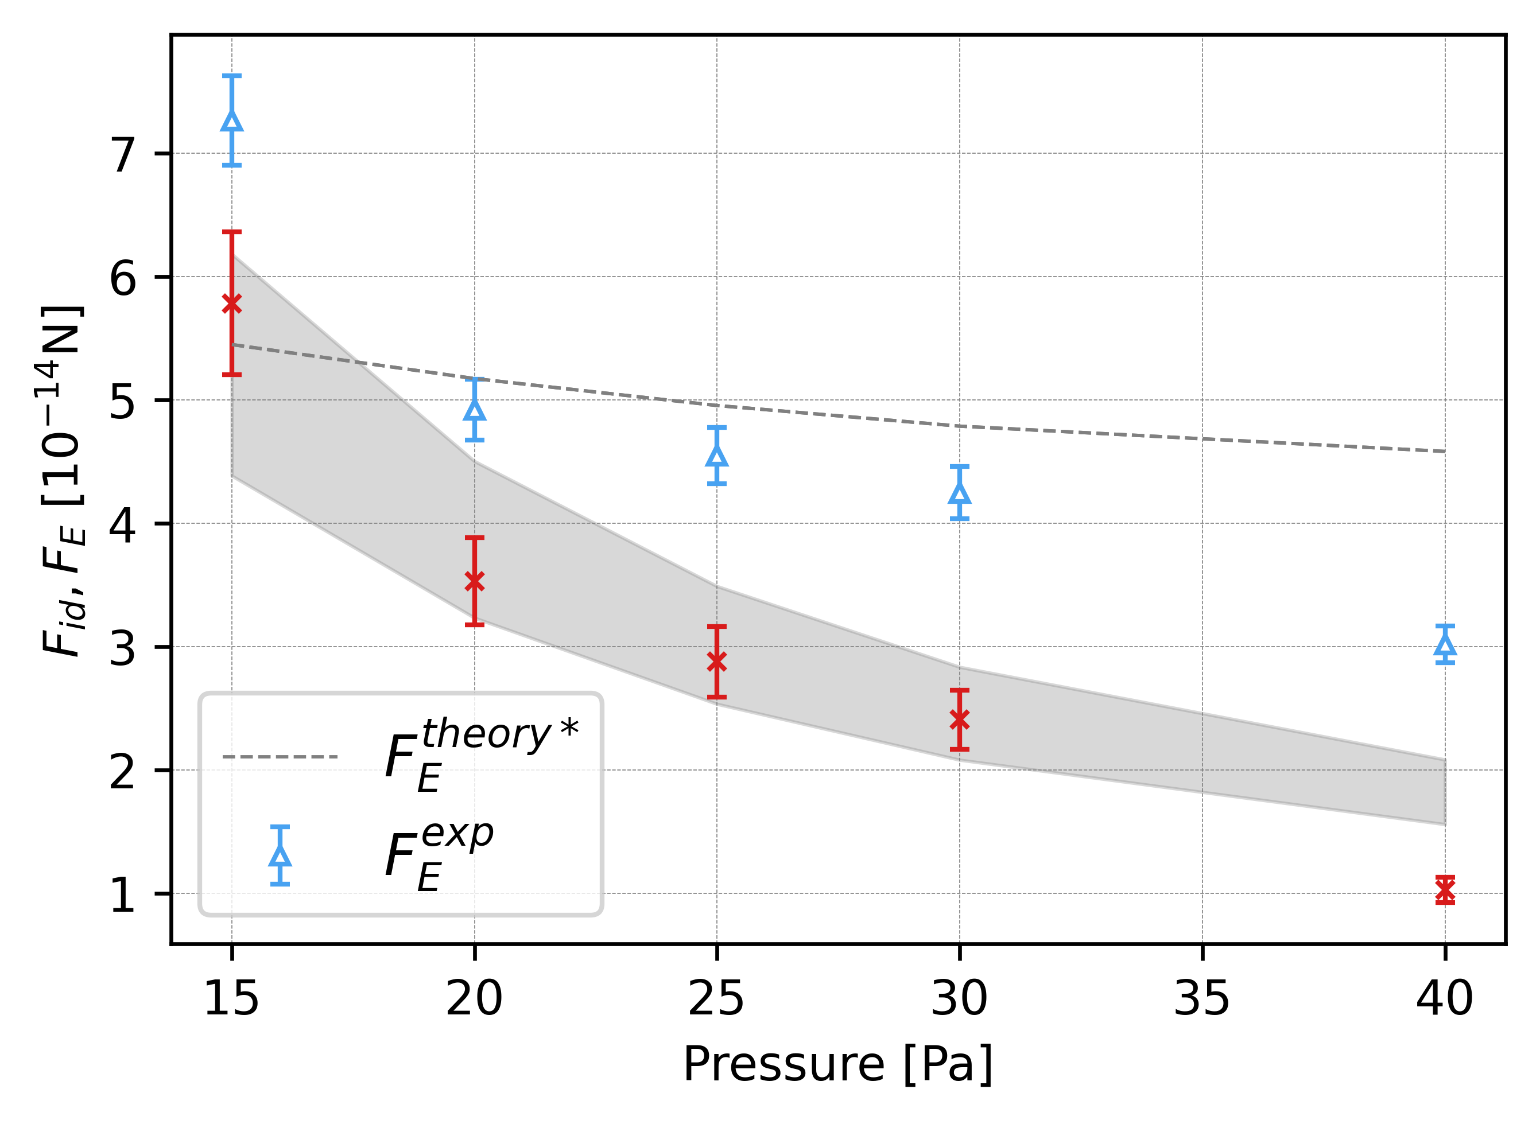

Slide 16
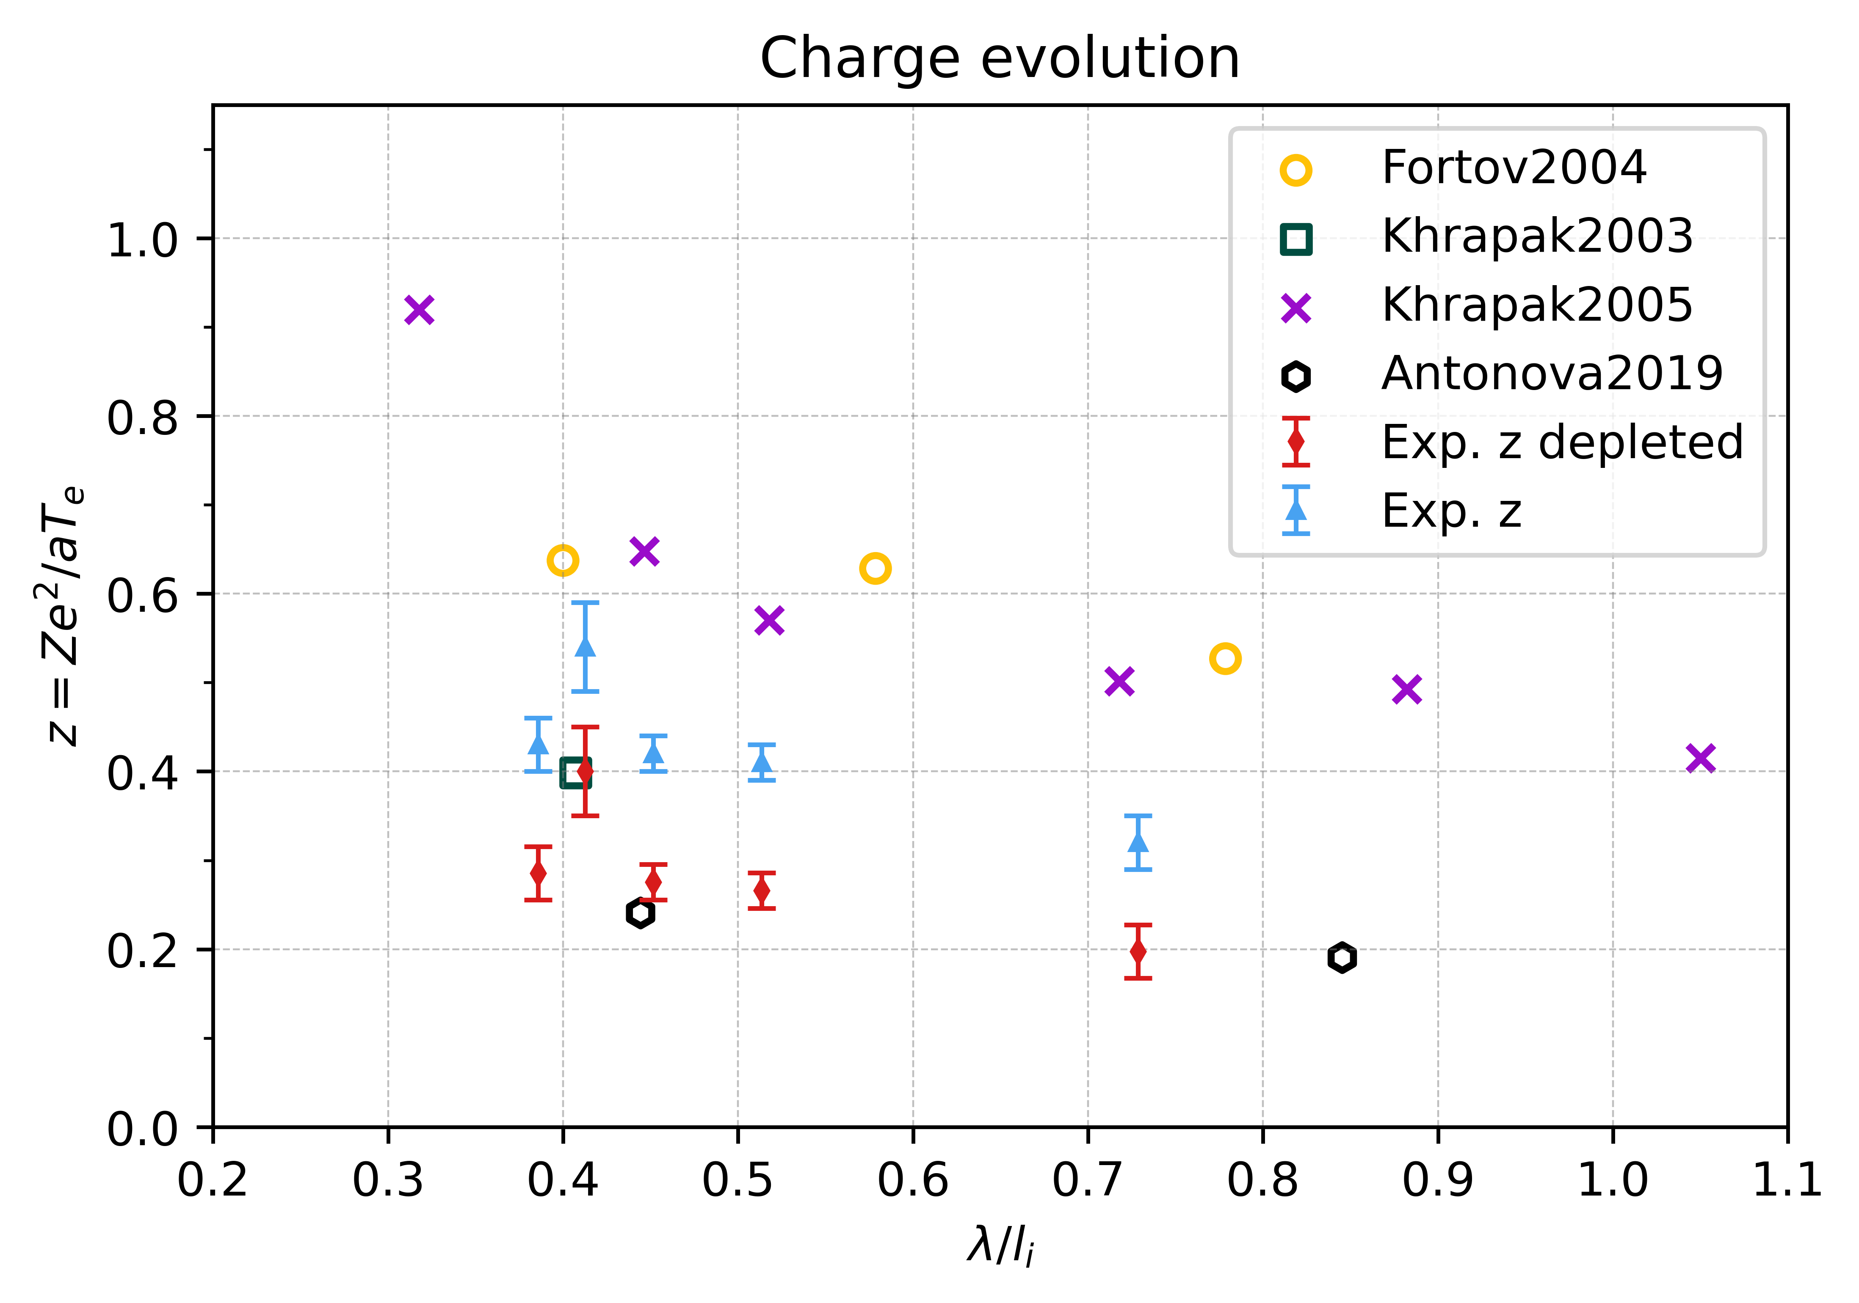
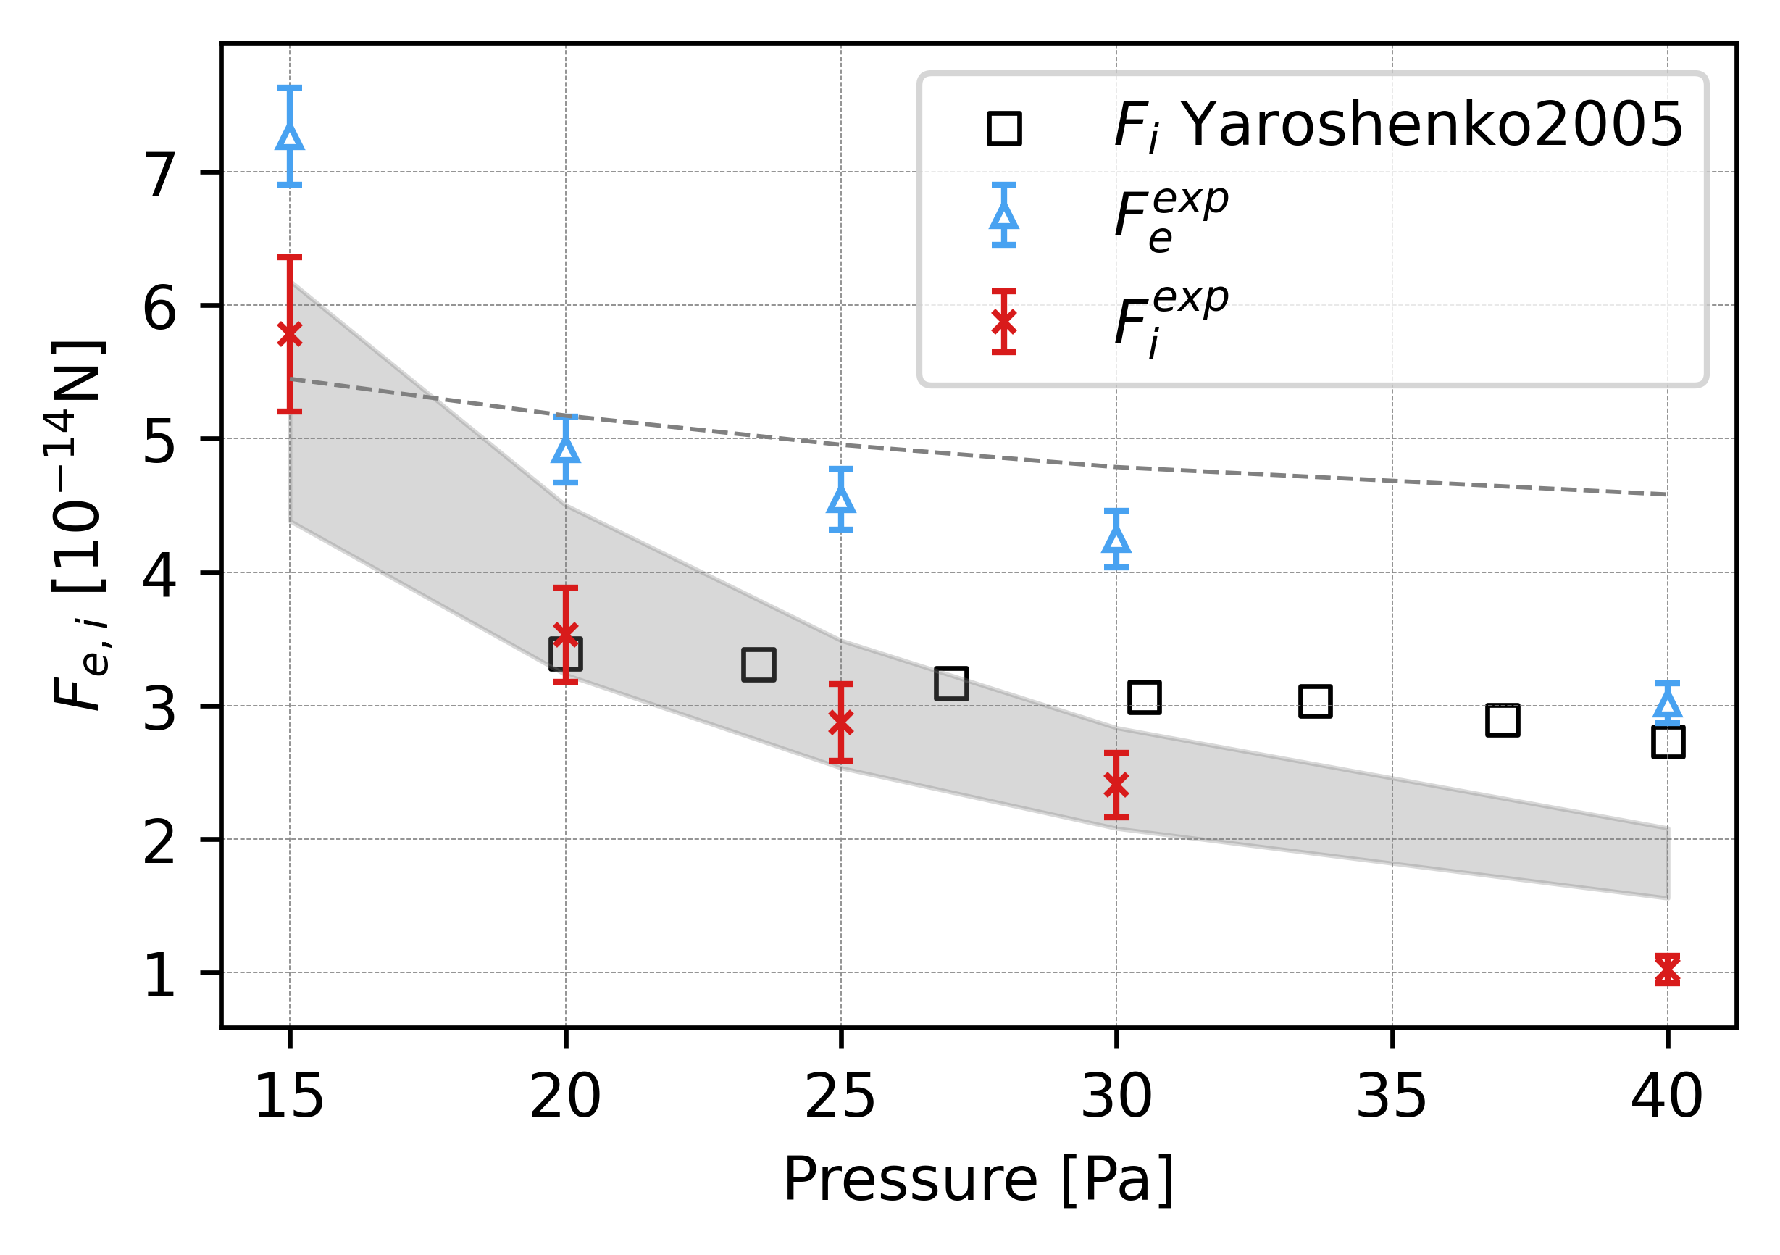

Slide 17
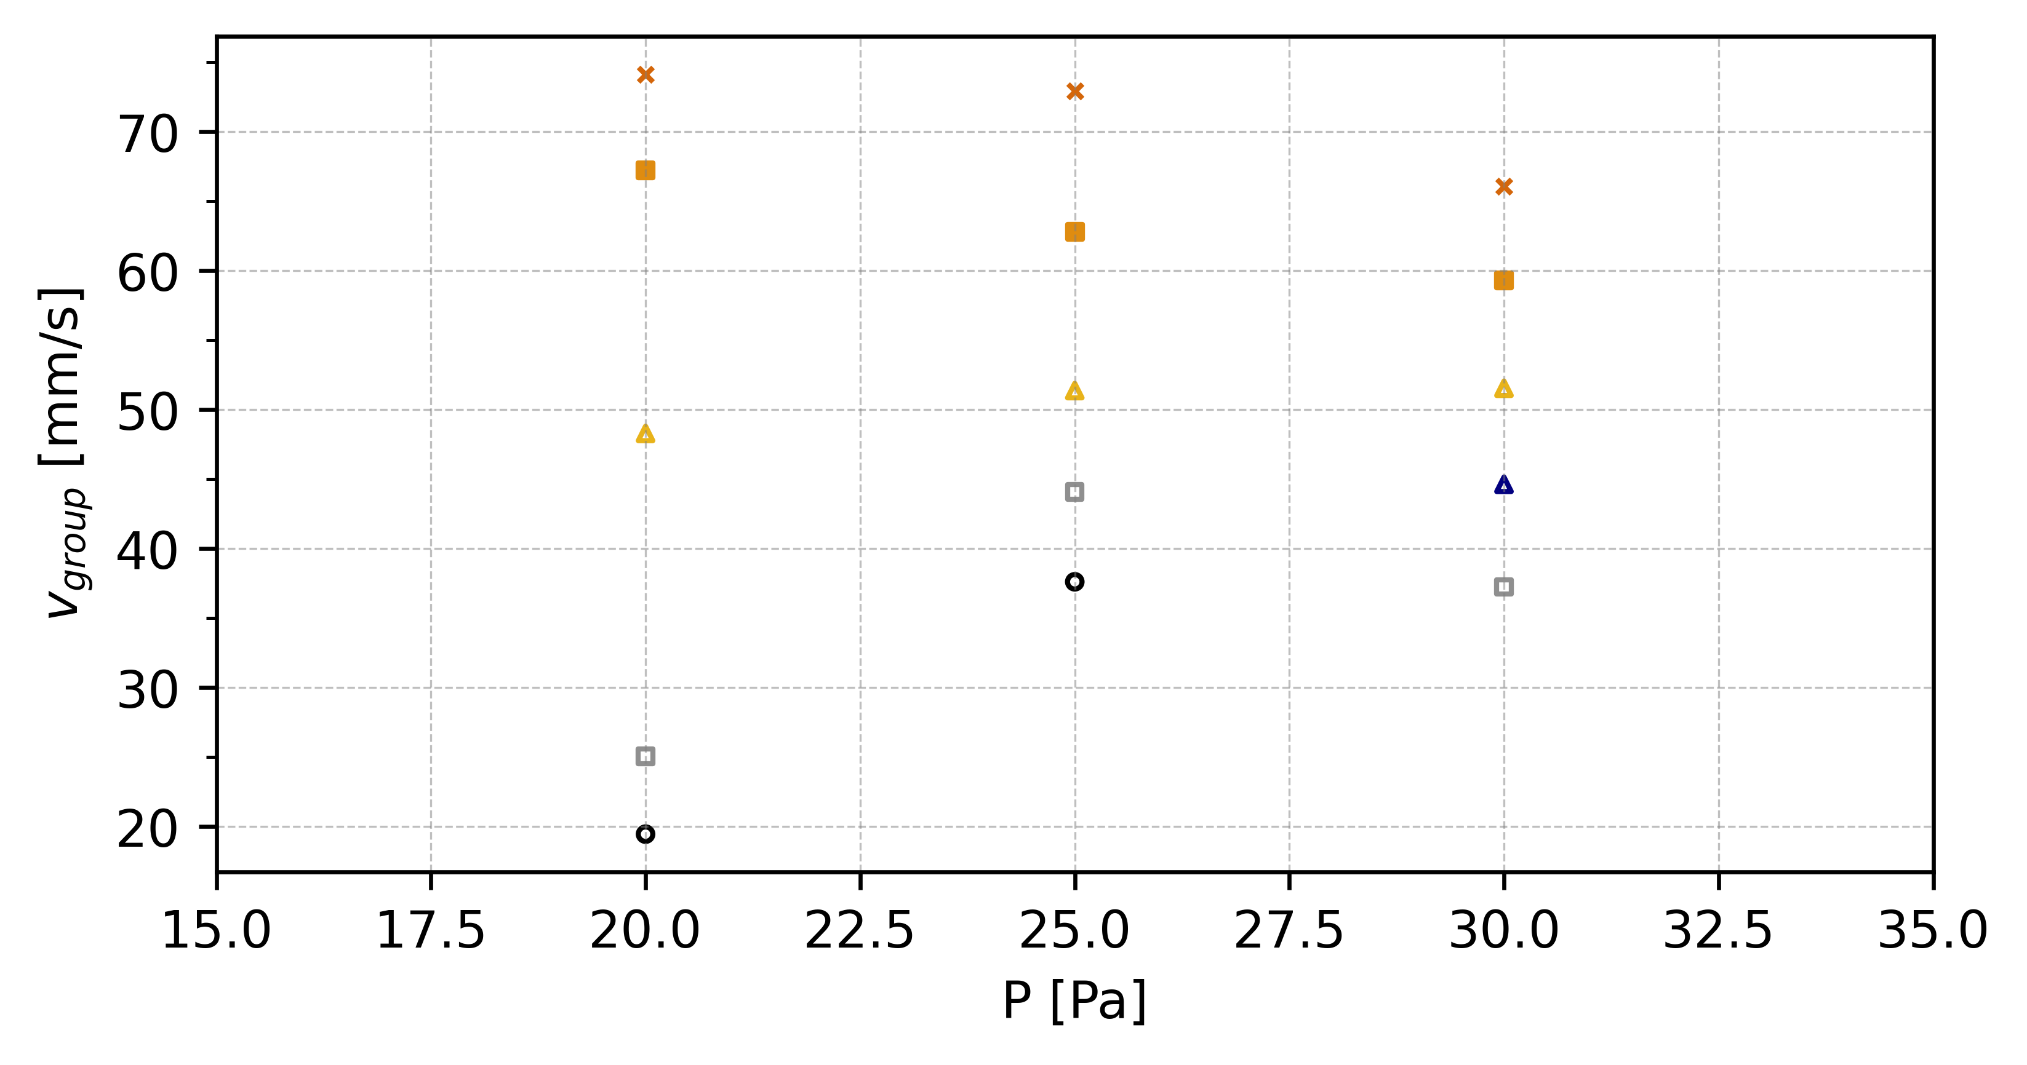
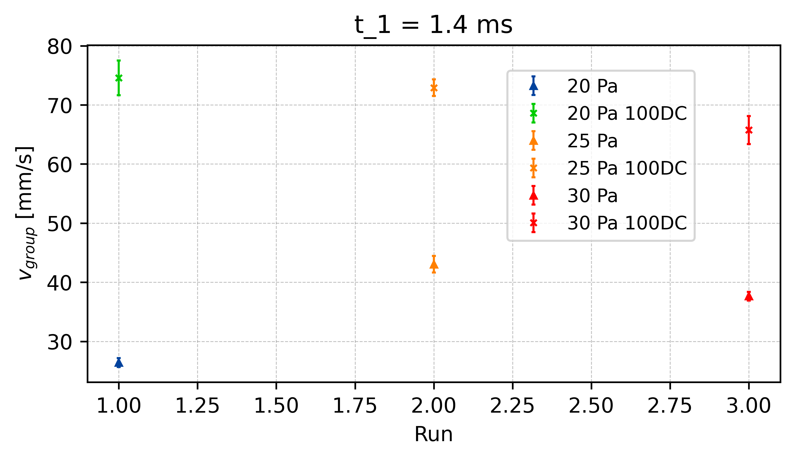
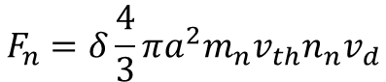
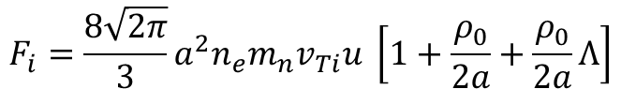
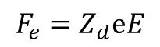
Reduction of Electric Field - v_{group}
t = 1.3ms
E_{effectiv} = 30%
100%
t = 1.4ms
E_{effectiv} = 40%
t1.4
80%
t = 1.5ms
E_{effectiv} = 50%
60%
t1.4
∆v_{25_t1.4}
t1.4
50%
∆v_{20_t1.4}
∆v_{30_t1.4}
$$F_{e}=Z_{d}ⅇE$$
40%
x E_eff
30%
$$F_{n}=δ\frac{4}{3}πa^{2}m_{n}v_{th}n_{n}v_{d}$$
$$F_{i}=\frac{8\sqrt{2π}}{3}a^{2}n_{e}m_{n}v_{Ti}u \left[1+\frac{ρ_{0}}{2a}+\frac{ρ_{0}}{2a}Λ\right]$$
x E_eff
x E_eff
Vergleiche: V_g vs P und V_g vs E

Slide 18
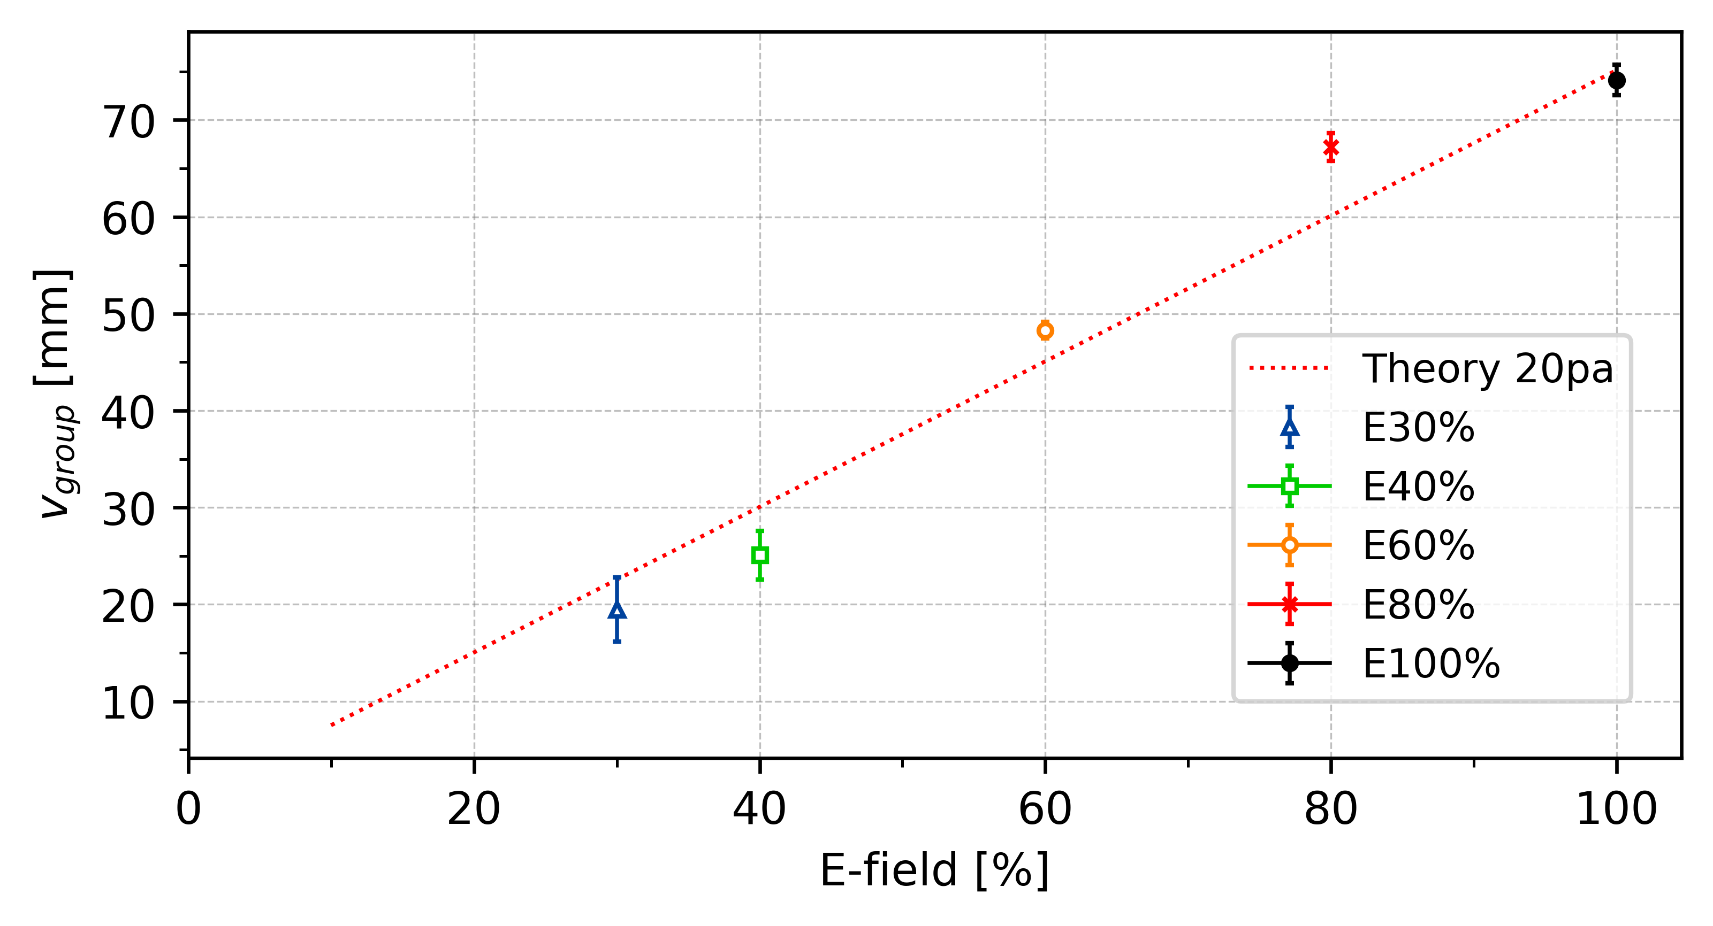
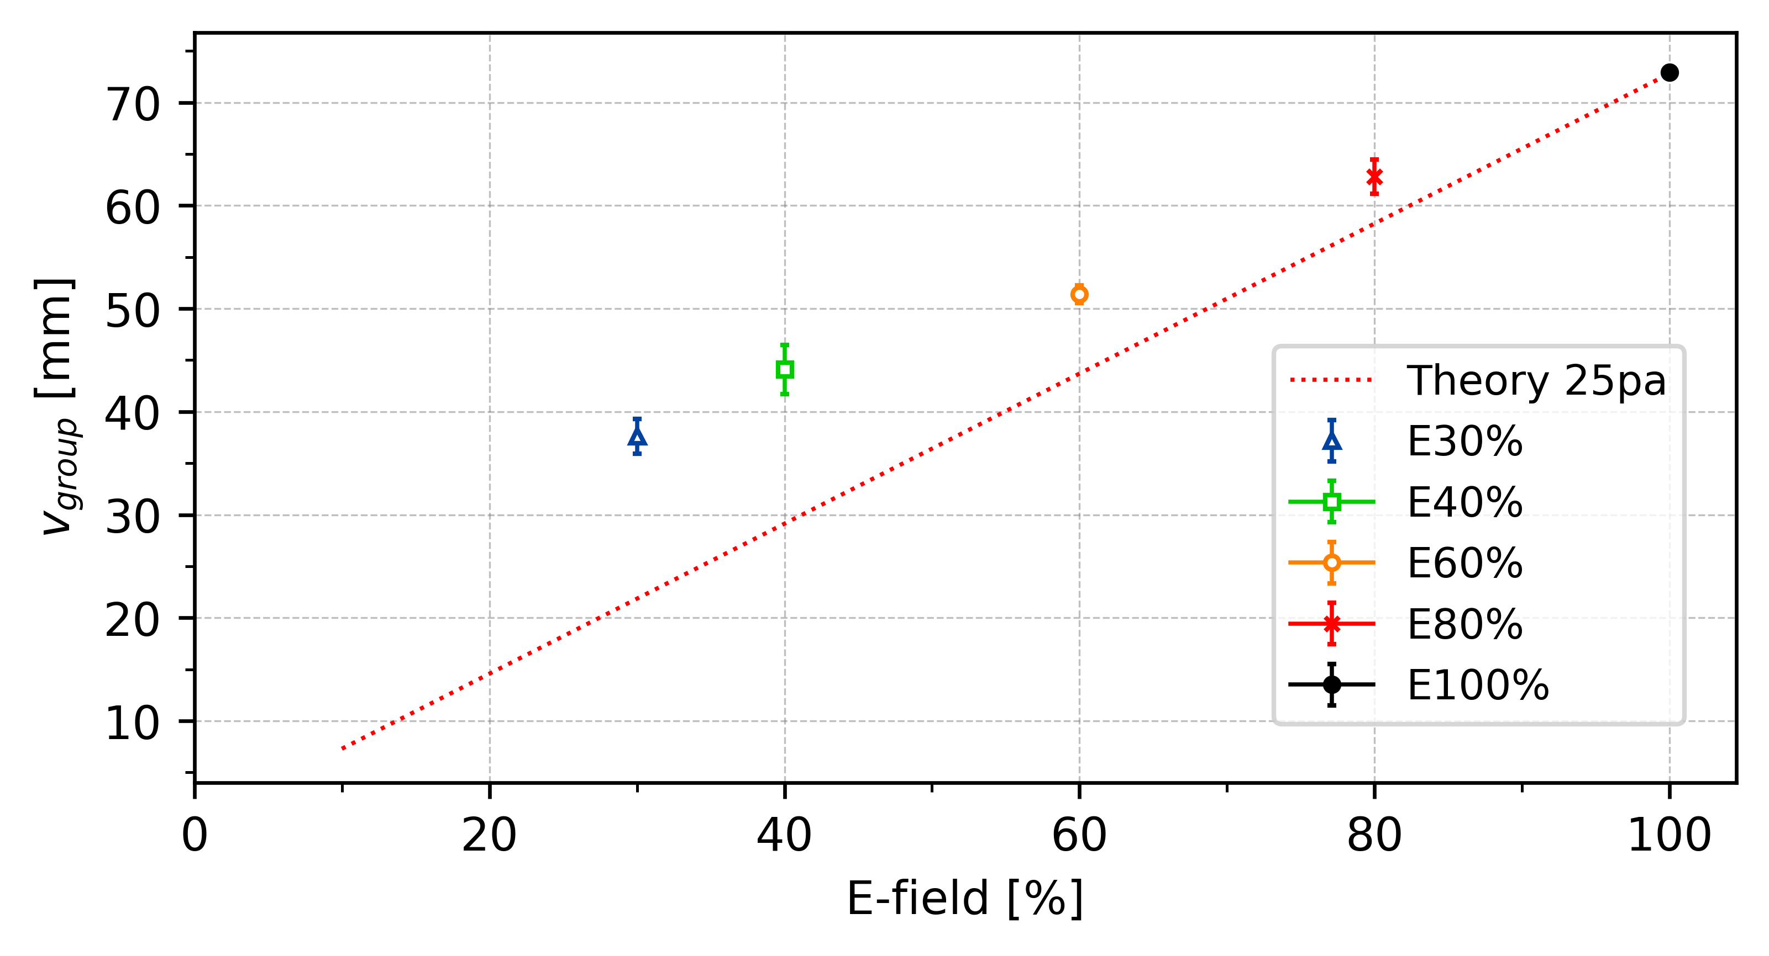
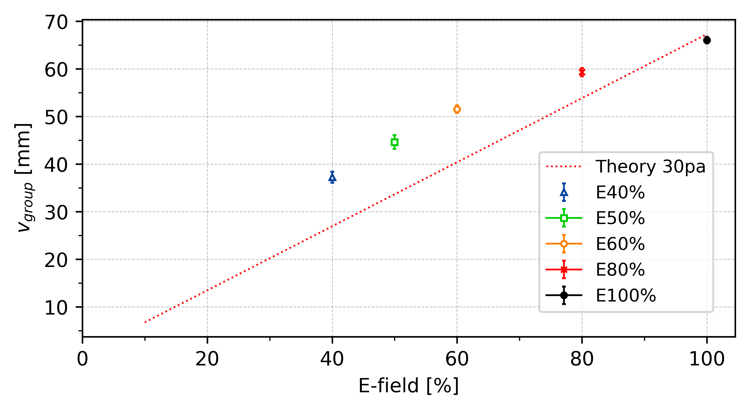
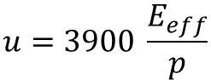
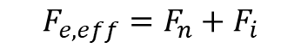
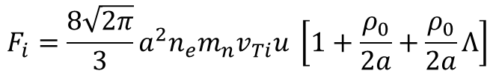

Reduction of Electric Field - v_{group}
. . .
t = 1.3ms
E_{eff} = 30%
$$F_{e,eff}=F_{n}+F_{i}$$
t = 1.4ms
E_{eff} = 40%
$$F_{e,eff}=Z_{d}ⅇE_{eff}$$
t = 1.5ms
E_{eff} = 50%
. . .
$$F_{i}=\frac{8\sqrt{2π}}{3}a^{2}n_{e}m_{n}v_{Ti}u \left[1+\frac{ρ_{0}}{2a}+\frac{ρ_{0}}{2a}Λ\right]$$
$$u=3900 \frac{E_{eff}}{p}$$
Modified frost formular?

Slide 19




Slide 20


Reduction of Electric Field - C_{DAW}
t = 1.4ms
E_{effectiv} = 40%

Slide 21



Reduction of Electric Field - C_{DAW}
*E_eff[%]
Or ?
*E_eff[%]

Slide 22




Slide 23



Slide 24



Slide 25



Slide 26



Slide 27

p(x)

Slide 28



Slide 29

Critical Electric Field - C_{DAW}
Pressure | C_Forward | E-field Forward | E-crit
20
20
25
25
30
30

Slide 30
Appendix

Slide 31


Polarity Difference
Average
∆c_20 = 11.0 mm/s ~ 14.5%
∆c_25 = 13.5 mm/s ~ 17.8%
∆c_30 = 7.8 mm/s ~ 11.9%
∆c_20
∆c_25
∆c_30

Slide 32


∆c_30 = 8.5 mm/s ~ 17.0%

Slide 33




Slide 34


-
∆c_25
∆c_30
∆c_20 = 4.5 mm/s ~ 14.5%
∆c_25 = 7.5 mm/s ~ 15.5%
∆c_30 = 6.9 mm/s ~ 15.5%
∆c_20

Slide 35

331 = 3,9058 mm
10 f = 0,16 sec
24,3 mm/s

